Slide 1
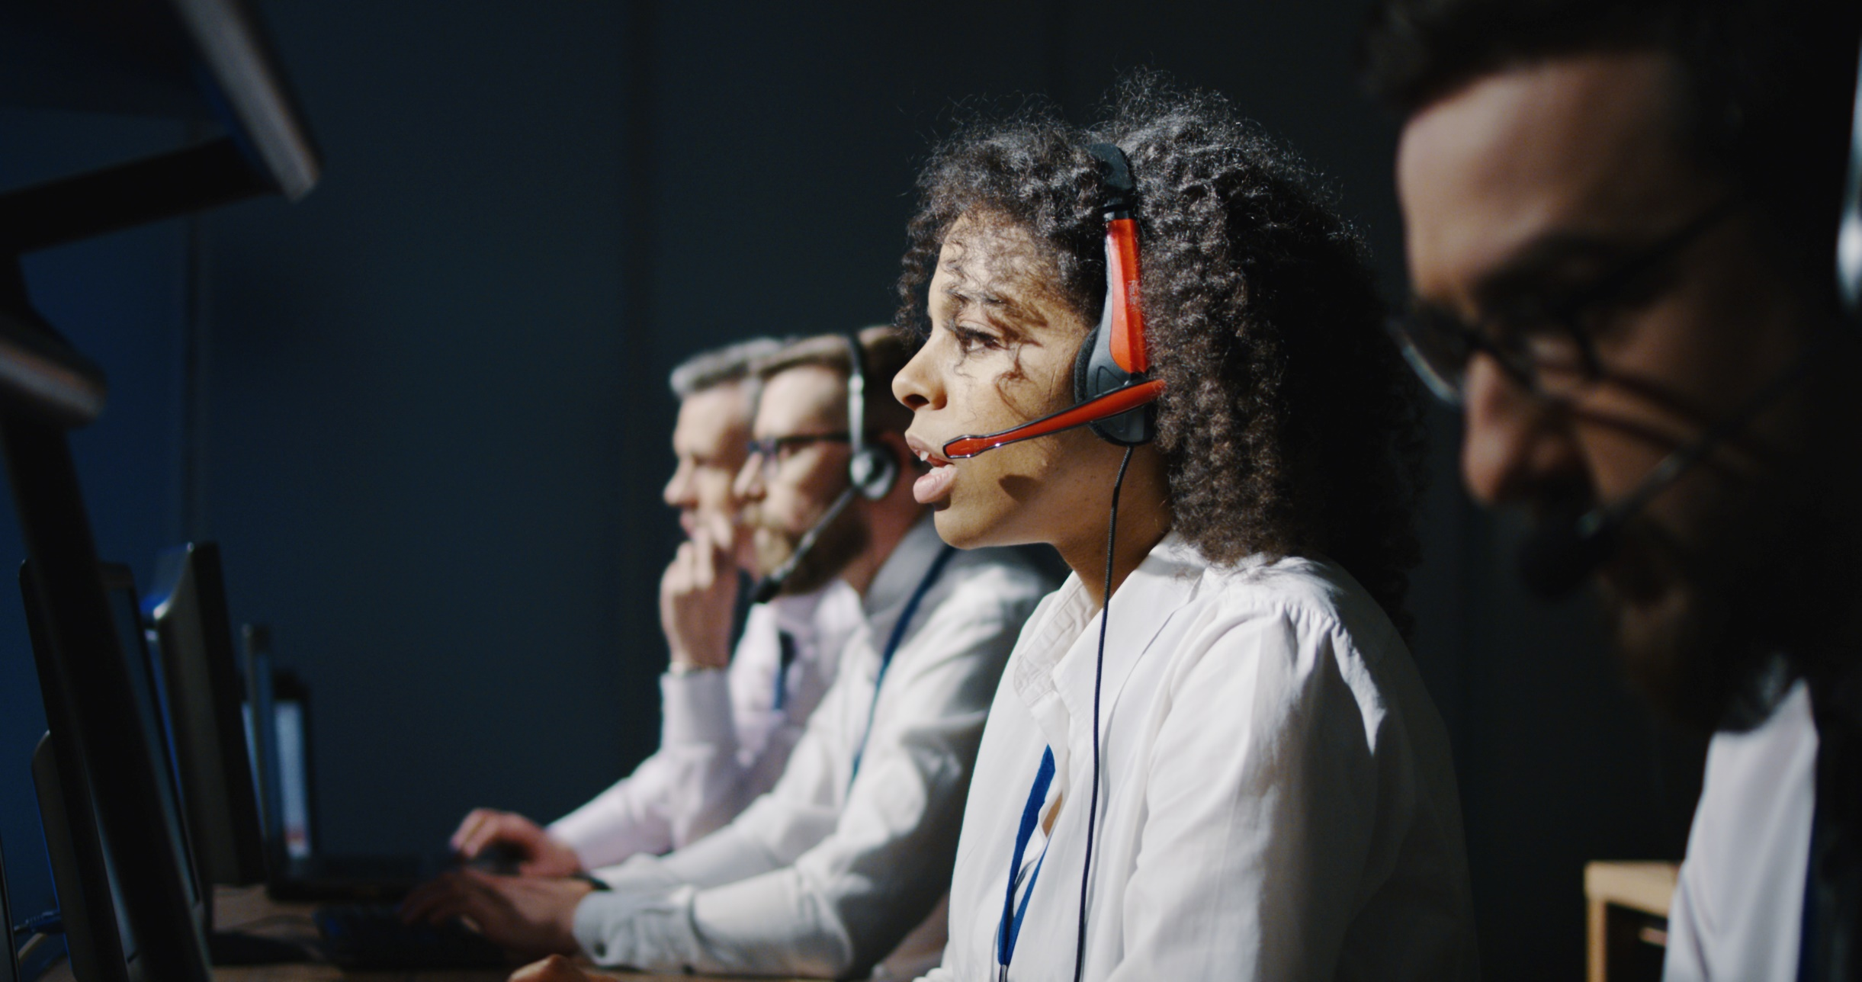
Advances in Crisis Communication
Dr. Vincent T. Covello
Director, Center for Risk Communication
New York City (US)/Geneva (Switzerland)
917-270-5280
vincentcovello@yahoo.com
Strengthening Communication in Times of Crisis

Slide 2
Agenda
Part 1: Introduction
Part 2: Crisis Communication and Neuroscience
Part 3: Crisis Communication and AI: Benefits, Challenges, and Opportunities

Slide 3
Topic 1:
Introduction

Slide 4
Presenter:
Dr. Vincent Covello
Researcher - e.g., 150 scientific articles, 25 books
Teacher and Professor –
Brown University, Columbia University, …
Practitioner - COVID-19, EBOLA, ZIKA, BP Oil Spill, 9/11, PFAS (“Forever Chemicals”), Bird Flu, etc.

Slide 6
Dubious Achievement
Very Frequent Flyer

Slide 7
Brain Imaging Techniques
fMRI (Functional magnetic resonance imaging): measures changes in blood oxygenation and flow in response to neural activity
PET (Positron Emission Tomography): measures trace amounts of short-lived radioactive material to map functional processes in the brain.
CT scan (Computed tomography scanning): measures differential absorption of X-rays.

Slide 8

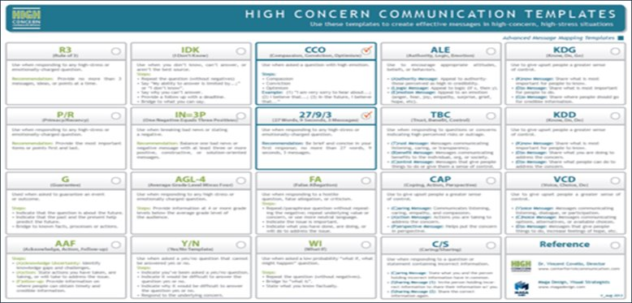
Crisis Communication:
Best Practices Toolbox

Slide 9
Crisis Communication
Principles
and Tools with Practical Implications
When people are stressed, such as in times of crisis, they will typically:
have difficulty processing more than 3 messages at a time (R3 Risk and Crisis Communication Tool)
want to know you care before they care what you know (CCO Risk and Crisis Communication Tool)
focus most on what they hear first and last (Primacy/Recency Risk and Crisis Communication Tool)

Slide 10
4 More Crisis
Communication
Principles and
Tools
When people stressed, such as in times of crisis, they will typically:
focus more on negatives than positives (1N=3P Risk and Crisis Communication Tool)
process information at well below their educational level (AGL-4 Risk and Crisis Communication Tool)
focus more on visual and non-verbal cues than on words
make worst-case assumptions about many commonly used words (e.g., the word “but”)

Slide 11

Three Key Messages
Effective crisis communication
is a
science-based discipline
Perceived high risk situations
change the
rules for
effective
communication
The key to
effective crisis
communication
is
Anticipation,
Preparation,
Practice (APP)

Slide 12
APP Strategy
(A) Anticipate
(Issues, Stakeholders, Questions or Concerns)
(P) Prepare
(Messages, Messengers, Means/Methods)
(P) Practice
(Rehearsals, exercises, simulations)

Slide 13
APP Strategy
(P) Prepare
(Messages)

Slide 14
Messaging
Good news:
95 percent of high concern questions for virtually any crisis scenario can be predicted in advance
    Document review
    Interviews with subject matter experts
    Interview yourself

Slide 15
FAQs
50 Most Frequently Asked Questions by Terminally Ill Patients
77 Most Frequently Asked Questions During a Disaster
65 Most Frequently Asked Questions during a pandemic
101 Most Frequently Asked Questions at a Environmental Clean-Up Site
205 Most Frequently Asked Questions about Drinking Water Contamination
45 Most Frequently Asked Questions about Ebola
420 Most Frequently Asked Questions about Exposure to Radiation
435 Most Frequently Asked Questions about a Mass Shooting Event*
* AI generated

Slide 16
When people stressed, such as when facing a crisis pr perceived high risk situation, they often:
Make worst-case assumptions about many commonly used words (e.g., the word “but”)

Slide 17
Words Matter
Especially in Times of Crisis
The word
“but”

Slide 18
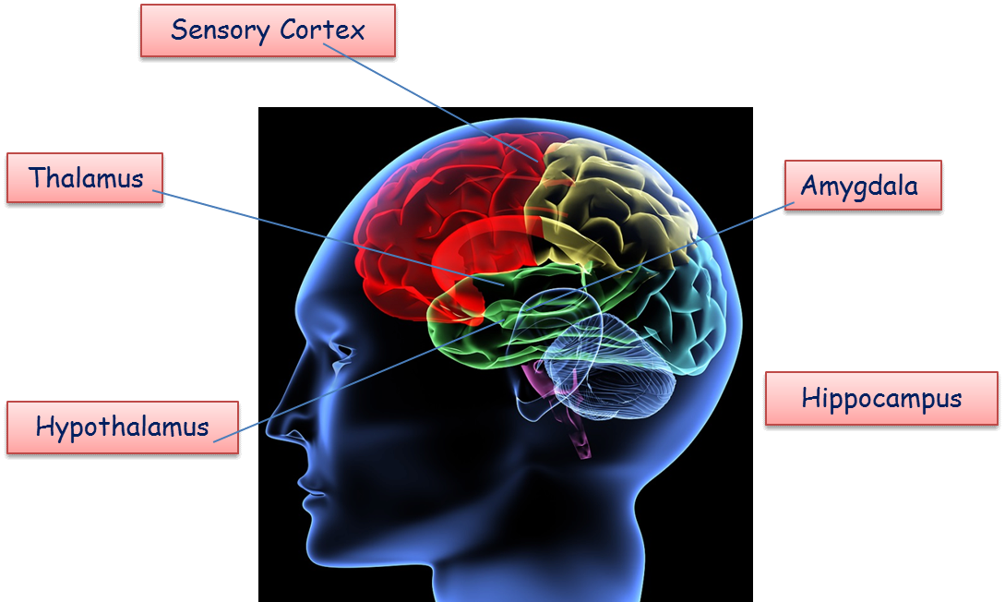
In high concern, high stress situations, commonly used words, such as the word “but” can hijack the brain (frontal lobe to
amygdala)

Slide 19
Answer the following question:
How does the brain process the word
“but” (as well as the words ”however” and “although”)
in a high stress or a perceived high-risk situation?

Slide 20
We like the work you are doing but..."

Slide 21
We are sorry for the delay but..."

Slide 22
Our work here is finally finished but …"

Slide 23
“We would love to help you but …"

Slide 24
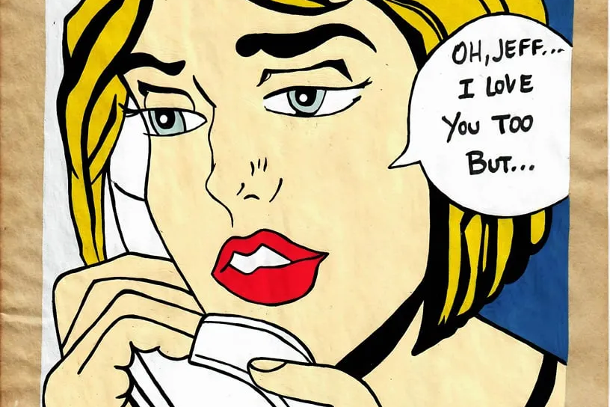

Slide 25
“Yes, but …"

Slide 26
“but” versus
“and”

Slide 27
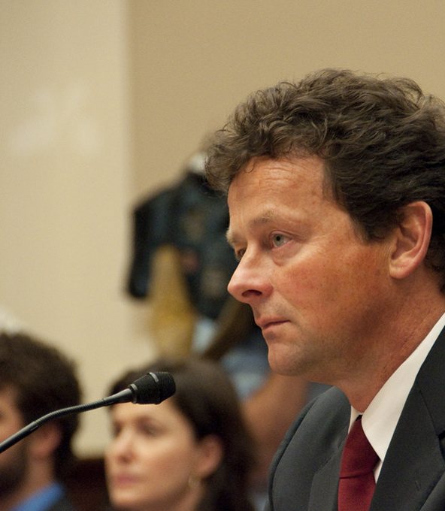
Case Study: Tony Hayward CEO
British Petroleum (BP) Oil Spill

Slide 28
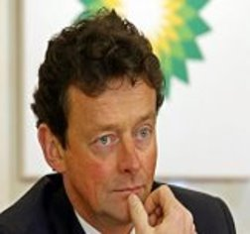
Case Study: BP Oil Spill (May 30,2010) BP CEO Tony Hayward
I’m sorry, we’re sorry for the massive disruption it has caused their lives.
And there is no one who wants this over more than I do.
I’d like my life back.

Slide 29
Behavioral and Neuroscience Research Finding
Risk situations change the way the brain processes words.
Examples of words changing their meaning in a risk situation:
  “but” (also, “although” “however”)
  “as you know” (also, “clearly” ”obviously”)
  ”never” “always” (also, absolutes such as ”all’ “every” “nothing”

Slide 31
Research: Behavioral and Neuroscience

Slide 32
Exercise
Answer the following question:
    How does the brain process the word
    “as you know”
    in a high stress or a perceived high-risk situation?

Slide 33
Words Matter
as you know
===
clearly
obviously
(evidently, plainly, patently, manifestly, unmistakably, undeniably, indubitably, incontrovertibly, demonstrably, unquestionably, undoubtedly, without doubt, of course, naturally, needless to say, …)

Slide 34
Case Study: Donald Rumsfeld’s “Known Unknowns” Message
News Briefing on Weapons of Mass Destruction in Iraq
February 12, 2002
“As we know, there are known knowns; there are things we know we know.
We also know there are known unknowns; that is to say we know there are some things we do not know.
But there are also unknown unknowns – the ones we don't know we don't know.”

Slide 35
Exercise
Answer the following question:
    How does the brain process the words
    never and always
    in a high stress or a perceived high-risk situation?

Slide 36
Absolutes
“We/You always…”
“We/You never…”
“I/We guarantee you that…”
===
“no” and “not” when used as absolutes

Slide 37
BP Oil Spill
CEO
Tony Hayward
(May 30, 2010)
I’m sorry, we’re sorry for the massive disruption it has caused their lives.
And there is
no one
who wants this over more than I do.
I’d like my life back.

Slide 38
Absolutes
Never
Always
Every
All
Guarantee
===
“No”
“Not”

Slide 39
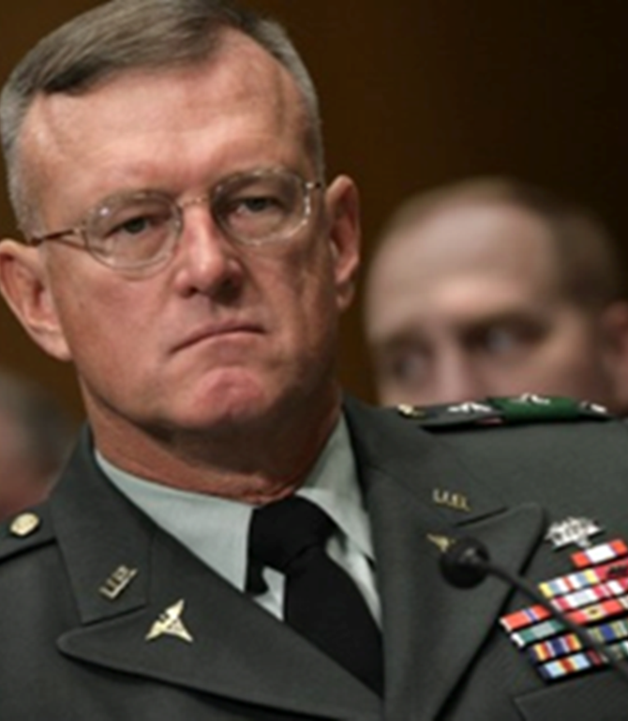
Case Study: Housing for Wounded Soldiers at Walter Reed Hospital (2007)

Slide 40
Q.: Do you hold yourself accountable for the squalid conditions provided for wounded soldiers at Walter Reed Hospital
A.: I’m trying not to say I’m not accountable.
Q.: How could you not have known?
A.: I don’t do barracks inspections at Walter Reed Hospital.
Q. Why did you do so little?
A. Walter Reed is not my only command.
Case Study and Exercise:
Walter Reed Hospital
Congressional Testimony
March 6, 2007, Washington Post
Exercise: Describe 3 things you like or dislike in the communication

Slide 41
Words Matter
“Change” versus “Update”
Example:
“Our advice may change”
vs.
“Our advice will be updated as needed.”

Slide 42
Words Matter
“Whatever”
==
“What statistics?”
“You think this is an example of where the anger gets away from us."

Slide 43
“You are letting your emotions get hold of you.”

Slide 44
“I know how you must feel”

Slide 45
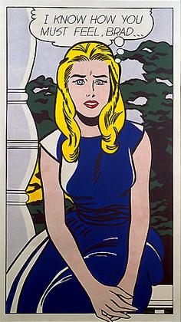

Slide 46

Research: Behavioral and Neuroscience
LeDoux J. Cellular and Molecular Neurobiology. October 2003, Volume 23, Issue 4, pp 727-738, Image from www.basingtonstokekarate.com

Slide 47
3 Questions
What are the best science-based crisis communication tools and techniques?
Can we improve our crisis communications?
How can we communicate more effectively in noisy environments?

Slide 48
Homework
In times of crisis, the brain often changes the way words are processes and understood.
Linguistic Homework Assignment:
Be aware/notice when you say:
  “but” (also, “although” “however”)
  “as you know” (also, “clearly” ”obviously”)
  ”never” (also, absolutes such as ”always” “every” “nothing”)
===
Be aware/notice when you say “no” or ”not”

Slide 49
Best Practices Toolbox

Slide 50
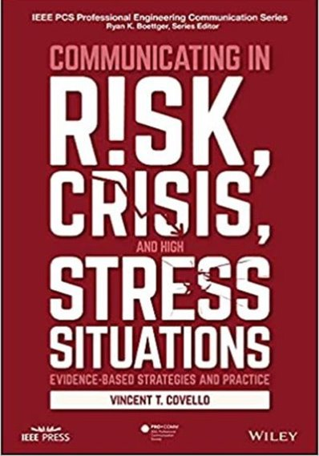
Crisis Communication Resource
•500 pages
•3000 references to the peer reviewed scientific literature
• Numerous case studies and case diaries
Includes chapters on Social Media, Stakeholder Engagement, Communicating Complex Numbers, AI, etc.

Slide 51
Crisis Communication Resources
Kahneman, D., (Noble Prize Winner) Thinking Fast and Slow (2011)
Hyer, R., and Covello, V., Effective Media Communication in Public Health Emergencies: A World Health Organization Handbook (2007)
Covello, V.T., Communicating in Risk, Crisis, and High Stress Situations: Evidence-Based Strategies and Practice (2022)
====
Aristotle, Rhetoric: The Art of Persuasion

Slide 52
The Changing Landscape for Crisis Communication

Slide 53
Crisis Communication Goals
Trust: (Build or repair trust)
Inform: (Informing Decision-Making by telling the truth and telling it well )
Relationships: (Build positive relationships that help people connect with one another)

Slide 54
Agenda
Part 1: Introduction
Differences between High Stress and Low Stress Communication
Part 2: Crisis Communication and Neuroscience

Slide 55
The Magic Number
3
R3 Tool:
(Rule of 3)
27/9/3 Tool
(27 Words, 9 seconds, 3 messages)
Message Maps

Slide 56
Best Practices Toolbox

Slide 57
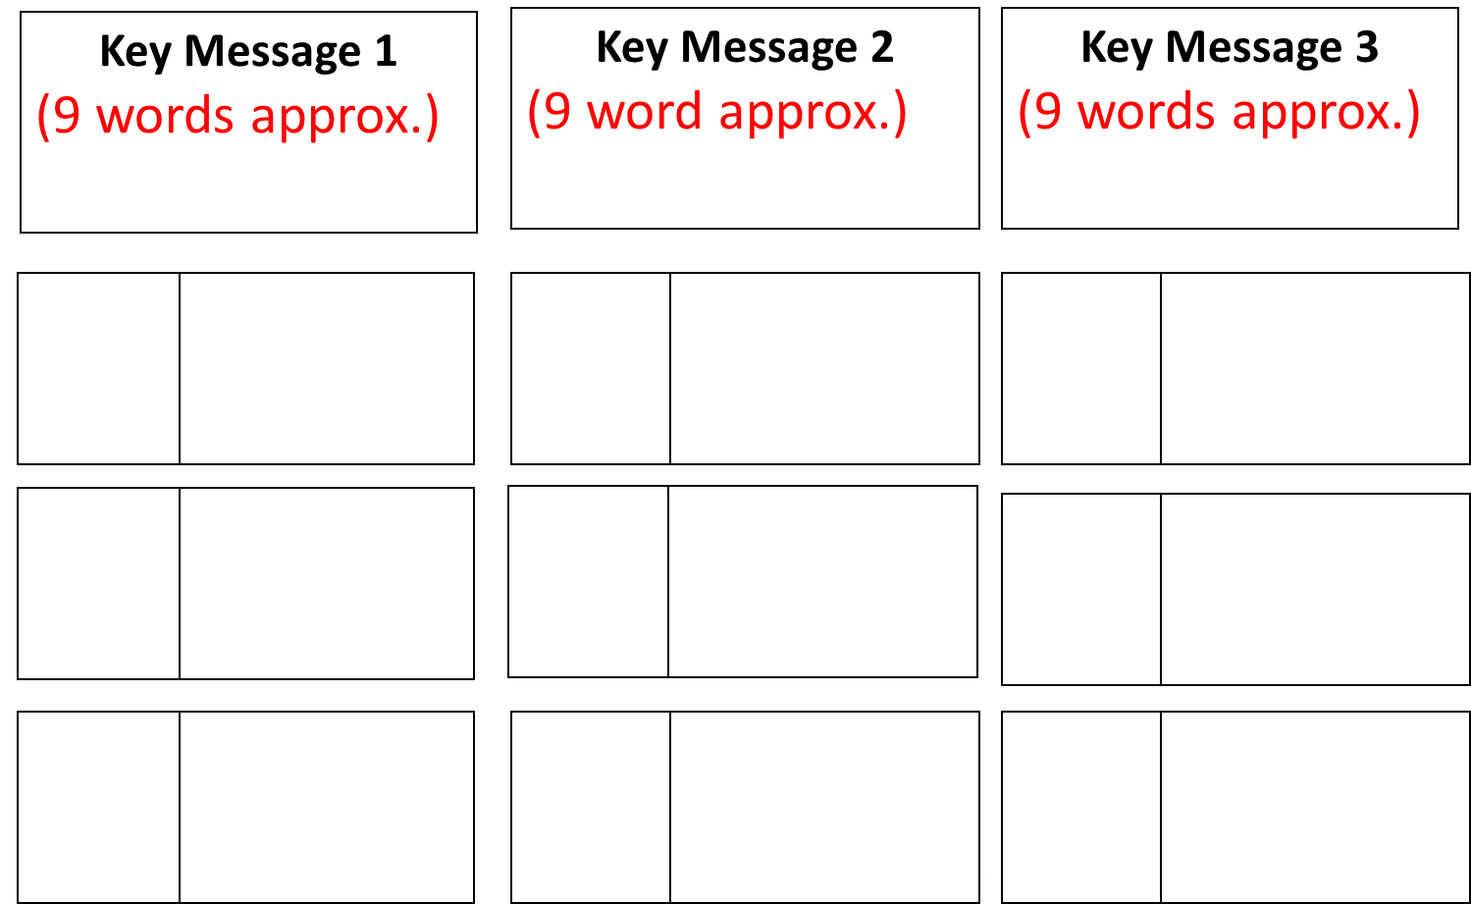
Toolkit: Message Map

Slide 58
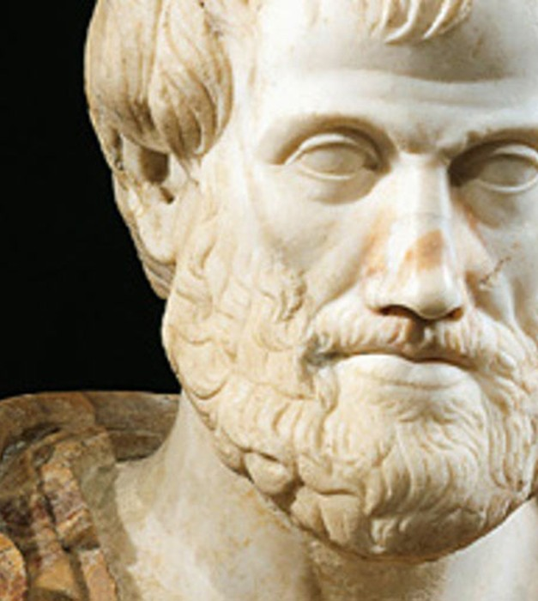
Aristotle and the
Magic
Number 3

Slide 59
Rule of 3
Aristotle: (ALE Tool)
  Message 1: Authority
  (ethos)
  Message 2: Logic
  (logos)
  Message 3: Emotion
  (pathos)

Slide 60
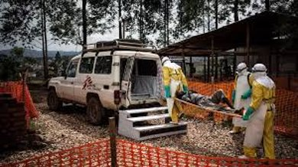
Case Study and Exercise
Ebola, West Africa, 2014
Exercise: Craft a set of messages inviting health care workers to come to West Africa to help address the Ebola outbreak.
For your communications, what would be your:
  Authority (ethos) message
  Logic (logos) message
  Emotion (pathos) message

Slide 61
Rule of 3 (R3) Tool
27/9/3 Tool
(27 words,
9 seconds,
3 messages)

Slide 62

Crisis Communication
Slogan of New Zealand Prime Minister Jacinda Arden
COVID-19 (2020-2022)
  Hit Hard
  Hit Fast
  Hit Often

Slide 63
APP
(A) Anticipate (Issues, Stakeholders, Concerns)
(P) Prepare (Messages, Messengers, Means of Communication)
(P) Practice (Rehearsals, Exercises, Simulations)

Slide 64
Primacy/Recency
People under stress tend to focus most on what they hear first and last
(Primacy/Recency Crisis Communication Tool)

Slide 65
CDC Mantra for Crisis Communication
  Be first
  Be right
  Be credible
4 Hit Theory of Belief Formation
(transformation of a fact or viewpoint into a “belief”)

Slide 66
CDC Mantra for Crisis Communication
  Be first
  Be right
  Be credible
4 Hit Theory of Belief Formation
(transformation of a fact or viewpoint into a “belief”)
https://www.cdc.gov/healthcommunication/risk_communication.html

Slide 67
Message Map
“Hit Hard,
Hit Fast,
Hit Often”
Key Message
1
Key Message
2
Key Message
3
1.1
2.1
3.1
1.2
2.2
3.2
1.3
2.3
3.3

Slide 68
Social Meda:
Jacinda Ardern
Facebook Breakfast Meetings (6:30 am)
Supplemented by postings of key messages on:
-- Instagram
-- Twitter (X)
-- YouTube
-- TikTok
-- …

Slide 69
Message Mapping Clinic

Slide 70
Message Map
Template
Question? or Concern!
<<Empathetic transition>>
Key Message 1
Key Message 2
Key Message 3
Support-ing
Info. 1.1
Support-
ing
Info. 2.1
Support-ing
Info. 3.1
Support-ing
Info. 1.2
Support-ing
Info. 2.2
Support-ing
Info. 3.2
Support-ing
Info. 1.3
Support-ing
Info. 2.3
Support-ing
Info. 3.3
Hyer, RN, Covello VT. Effective media communication during public health emergencies: a WHO handbook. WHO Press, Geneva, 2007

Slide 71
Message Map
Based on Rule of 3 Tool and 27/9/3 Tool

Slide 72
What is a “Message Map?”

Slide 73
Message Maps
Roadmaps for displaying detailed, hierarchically organized responses to anticipated high concern issues
Provide accurate and easily understood messages for high concern issues

Slide 74
Message Map
Key Message
1
Key Message 2
Key Message
3
1.1
2.1
3.1
1.2
2.2
3.2
1.3
2.3
3.3

Slide 75
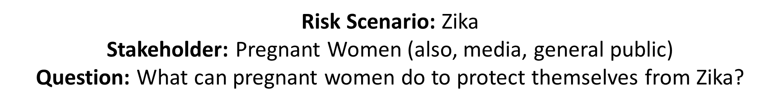
Key Message 1
Remove Standing Water
Key Message 2
Wear Protective Clothing
Key Message 3
Use Insect Repellent
1.1
Puddles
2.1
Long Sleeves
3.1
DEET
1.2
Flower pots/ Bird Baths/
Old Tires
2.2
Long Pants
3.2
23%-30%
DEET
1.3
Cup/Capful of Water
2.3
Dusk and Dawn
3.3
Medical Research
Notes:
Natausha suggested taking out arrows and replacing with Covello drawing instructions/correcting message maps when homework is presented; poll on ordering of message maps/ what is 27/9/3;

Slide 76
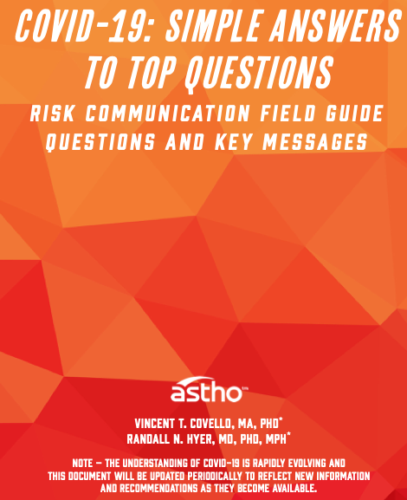

Slide 77
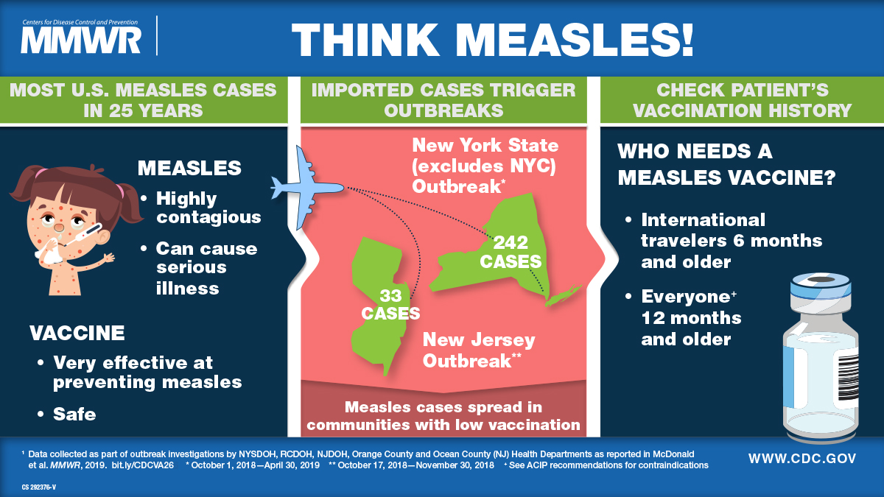
Infographic

Slide 78
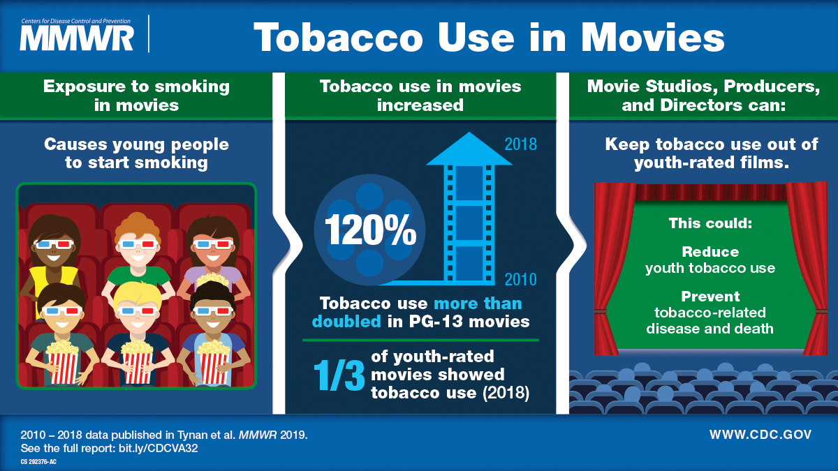

Slide 79
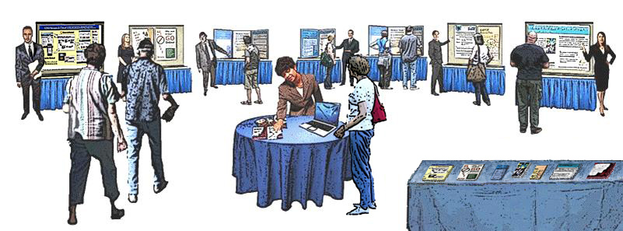
Open Houses/Poster Stations
Posters at an Open House/Expert Availability Style Meeting

Slide 80
Nine Principles of Message Mapping
3 key messages (presented in less than 9 seconds or 27 words)
(27/9/3 Tool)
Begins at an average educational grade minus four
(AGL-4 tool)
Puts the most important messages first and last
Primacy/recency (PR tool)
Cites third parties perceived by stakeholders as credible
Begins with a genuine statement of listening and caring
(CCO Tool)

Slide 81
Nine Principles of Message Mapping
Uses graphics, visual aids, analogies and narratives
Balances negatives and positives
1N = 3P Tool
Uses the “Tell me, Tell me more, Tell me again” model to present information
Each message in the map should be able to stand on its own (i.e., without reference to other messages)

Slide 82
Message Mapping Resource
ATSDR/CDC Communication Toolkit
“Message Mapping Template, Worksheet, and Checklist”
https://www.atsdr.cdc.gov/communications-toolkit/documents/12_message-mapping-tool-final-111015_508.pdf

Slide 83
Message Maps
Can be used to answer questions from stakeholders and address concerns
Can be used for drafting briefings and presentations
Can be repurposed, e.g., infographic; fact sheet; poster at an open house

Slide 84
Message Map Response FLOW
Question? or Concern!
<<Empathetic transition>>
Key Message 1
Key Message 2
Key Message 3
1
(27,9,3)
5
(27,9,3)
Supporting Info. 1.1
2
Supporting Info. 2.1
3
Supporting Info. 3.1
4
Supporting Info. 1.2
Supporting Info. 2.2
Supporting Info. 3.2
Supporting Info. 1.3
Supporting Info. 2.3
Supporting Info. 3.3
(27,9,3)
(27,9,3)
(27,9,3)
Notes:
Natausha suggested taking out arrows and replacing with Covello drawing instructions/correcting message maps when homework is presented; poll on ordering of message maps/ what is 27/9/3;

Slide 85
Key Message 1
Remove Standing Water
Key Message 2
Wear Protective Clothing
Key Message 3
Use Insect Repellent
1.1
Puddles
2.1
Long Sleeves
3.1
DEET
1.2
Flower pots/ Bird Baths/
Old Tires
2.2
Long Pants
3.2
23%-30%
DEET
1.3
Cup/Capful of Water
2.3
Dusk and Dawn
3.3
Medical Research
85
Notes:
Natausha suggested taking out arrows and replacing with Covello drawing instructions/correcting message maps when homework is presented; poll on ordering of message maps/ what is 27/9/3;

Slide 86
Poster Stations
Posters at an Open House/Expert Availability Style Meeting

Slide 87
Agenda
Part 1: Introduction
Part 2: Crisis Communication and Neuroscience
Part 3: Crisis Communication and AI:
Benefits, Challenges, and Opportunities

Slide 88
Crisis Communication and Artificial Intelligence (AI)
AI is transforming crisis communication

Slide 89
Role of AI in Crisis Communication
AI can be used to:
enhance monitoring, analysis, and response
generate fact sheets and message maps
generate visuals

Slide 90
Benefits of AI
AI can be used to:
Quicky track public fears and outrage signals
(e.g., perceived fairness; perceived trust)
tailor messages to specific audience concerns
generate fact sheets
generate message maps
detect emerging risks

Slide 91
Risk Perceptions/
Fearn Factors/
Outrage Factors
Trust (High Trust vs. Low Trust)
Personal Control (Controlled by the Person vs. Controlled by Others)
Voluntariness (Voluntary vs. Coerced/Imposed)
Benefits (Clear vs. Unclear Benefits)
Fairness (Fair and Equitable vs. Unfair and Inequitable)
Victim Identity (Affects Adults vs. Affects Children)
Dread (Dreaded outcomes vs. benign outcomes)

Slide 92
AI:
Risks and Challenges
Misinformation and disinformation amplification
Bias in algorithms
Loss of human judgment
Ethical and privacy concerns

Slide 93
Best Practices
Use AI to support—not replace—expert judgment
Ensure transparency and explainability
Continuously validate outputs

Slide 94
Future Trends
AI-driven early warning systems
Personalized crisis messaging
Integration with emergency management systems
Greater regulation and governance

Slide 95
AI Homework Assignment
Draft a message map for a crisis-related question of interest to you using AI
Example:
Instructions to CHATGPT:
Based on the message mapping work of Dr. Vincent Covello, the World Health Organization, and CDC/ATSDR), draft a message map for the following question related to a radioactive crisis:
“What should people do in case of a radioactive accident?

Slide 96
AI Generated Message Map
Key Message 1: Get to a safe location and reduce exposure immediately.
  Go indoors as quickly as possible—preferably into a large building with thick walls.
  Move to a basement or the center of the building, away from windows and doors.
  Stay inside and avoid going outside until authorities say it is safe.
Key Message 2: Remove contamination to protect yourself and others.
  Remove outer clothing carefully
  Place clothing in a plastic bag and keep it away from people and pets.
  Shower with soap and water as soon as possible—do not use conditioner (it can bind radioactive material to hair).
Key Message 3: Follow official instructions and stay informed.
  Listen to local authorities via radio, TV, or trusted online sources.
  Evacuate only when instructed—sheltering may be safer.
  Follow guidance on food, water, and medical care (including potassium iodide if advised).

Slide 97
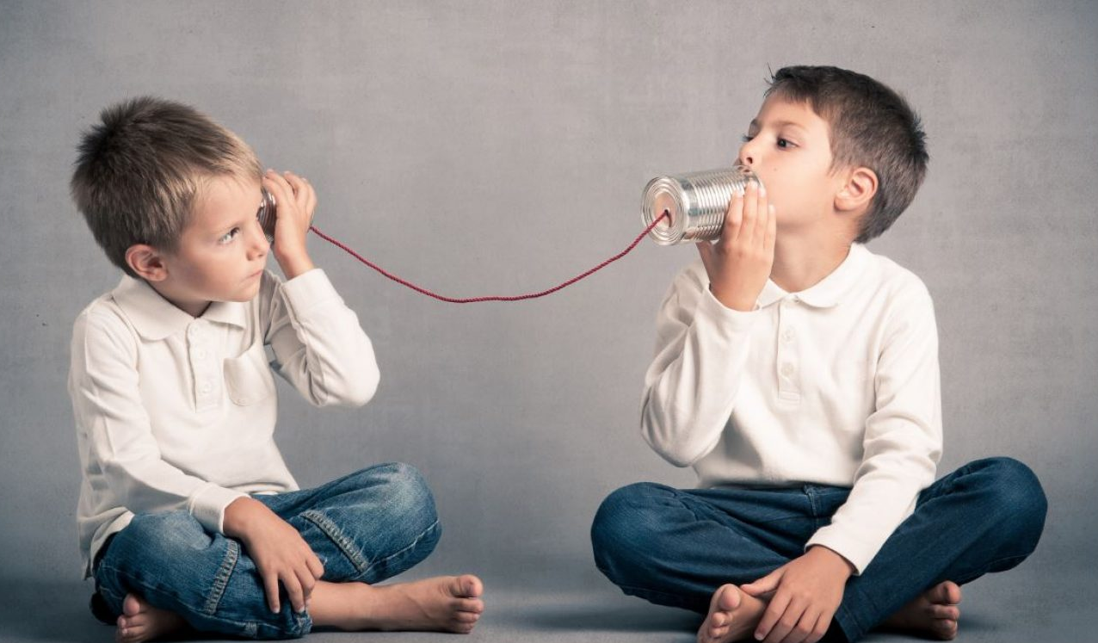
Wrap Up

Slide 99
Suggested Reading List (Short)
Kahneman, D., Thinking Fast and Slow
Covello, V. and Hyer, R, Effective Media Communication in Public Health Emergencies: A World Health Organization Handbook.
Covello, V., Communicating in Risk, Crisis, and High Stress Situations: Evidence-Based Strategy and Practice
===
Bok, S., Lying
Aristotle, Rhetoric: The Art of Persuasion

Slide 100
Ethics/
Honesty
Professor Sissela Bok
“Lying: Moral Choice in Public and Private Life”

Slide 101
Three Key Messages
Effective crisis communication
is a
science-based discipline
Perceived high risk situations
change the
rules for
effective
communication
The key to
effective crisis
communication
is
Anticipation,
Preparation,
Practice (APP)

Slide 102
Risk and Crisis Communication Tools
R3 Tool (27/9/3 Tool)
CCO Tool
1N=3P Tool

Slide 103
Risk, Crisis, and High Stress
Communication Principles
and Tools with Practical Implications
When people are stressed, such as when facing a crisis or perceived high risk situation, they often:
have difficulty processing more than 3 messages at a time (R3; 27/9/3 Risk and Crisis Communication Tools)
want to know you care before they care what you know (CCO Risk and Crisis Communication Tool)
focus most on what they hear first and last (Primacy/Recency Risk and Crisis Communication Tool)

Slide 104
4 More Principles and
Tools
with
Practical Implications
When people stressed, such as when facing a crisis pr perceived high risk situation, they often:
focus more on negatives than positives
(1N=3P Risk and Crisis Communication Tool)
process information at well below their educational level
(AGL-4 Risk and Crisis Communication Tool)
focus more on non-verbal communication than words and make worst case assumptions about their meaning.
make worst-case assumptions about many commonly used words (e.g., the word “but”)

Slide 105
Favorite crisis
communication
quotes
“If I had all day to cut down a large tree, I would use most of my day to sharpen my axe.”
(attributed to Abraham Lincoln)
“People want to know that you care before they care what you know”
(attributed to Aristotle and Will Rogers)
“It takes me on average three weeks to prepare an impromptu speech.”
(Mark Twain)

Slide 106
Thank You!

