Slide 1

Communicating with Neurodiverse Populations in an Emergency
Sarah Hardy, PhD
Licensed Psychologist
Hospital for Special Care Autism Center

Slide 2
Agenda
Defining neurodiversity
Autism Spectrum Disorder (ASD) as neurodivergence
Getting to know individuals with ASD
Strengths in individuals with ASD
Supporting communication
Accommodating fine motor and sensory differences

Slide 3

Conference Introductions
Tell me about your teams
What experience do you have with ASD or other neurodiverse identities?

Slide 4
Defining Neurodiversity

Slide 5
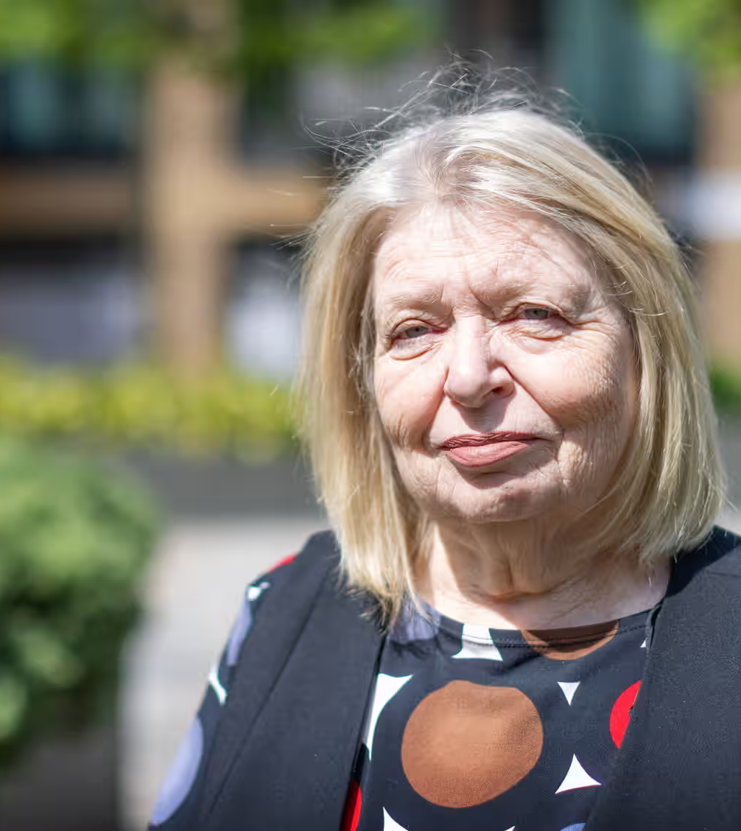
Neurodivergent vs. Neurotypical
Neurodivergent describes a person whose brain processes information in a way that is not typical of most individuals
(Craft, 2019; Singer, 1999)
Neurotypical refers to a person whose brain functioning falls within the dominant societal standards
Photograph: Anna Gordon/The Guardian
Notes:
Terms like neurodivergent were introduced in the 1990s by autistic sociologist Judy Singer as an alternative to deficit-based language, such as “disorder.” Singer highlighted notable strengths of many individuals in the autistic population that include abilities to focus, recognize patterns, and remember factual information.

Slide 6
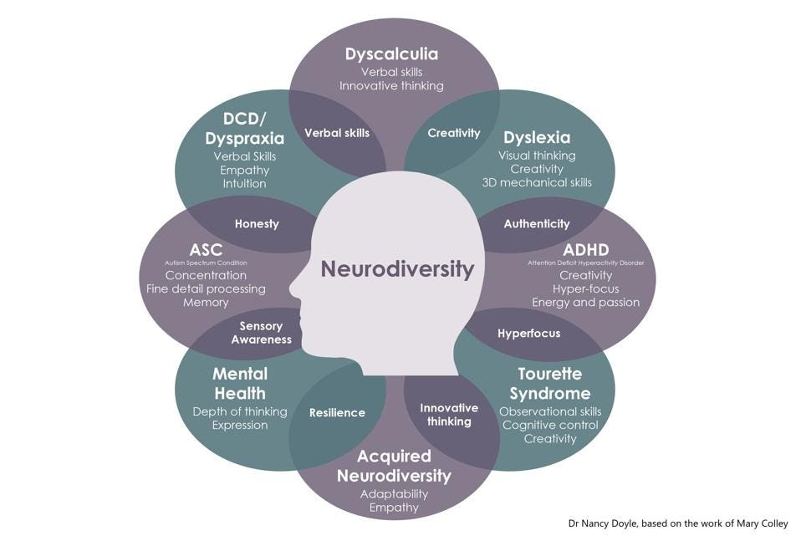
Strengths of
Neurodiversity

Slide 7
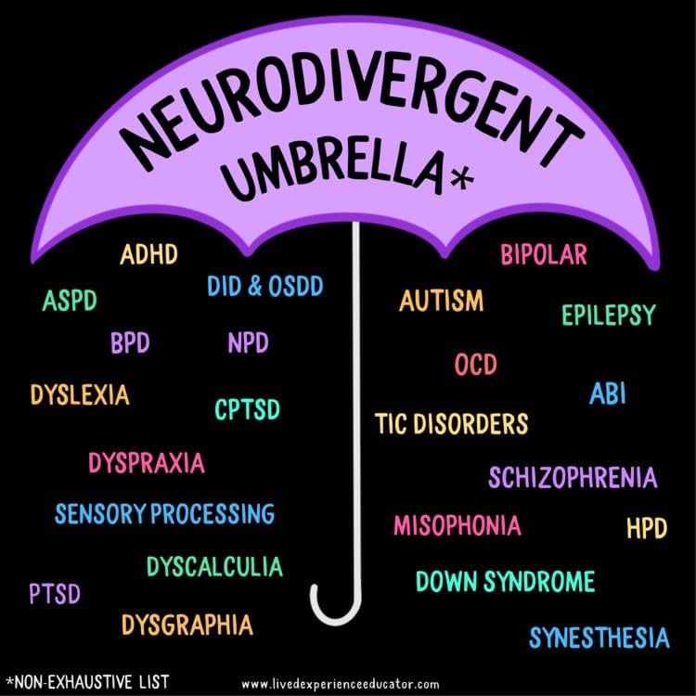

Slide 8
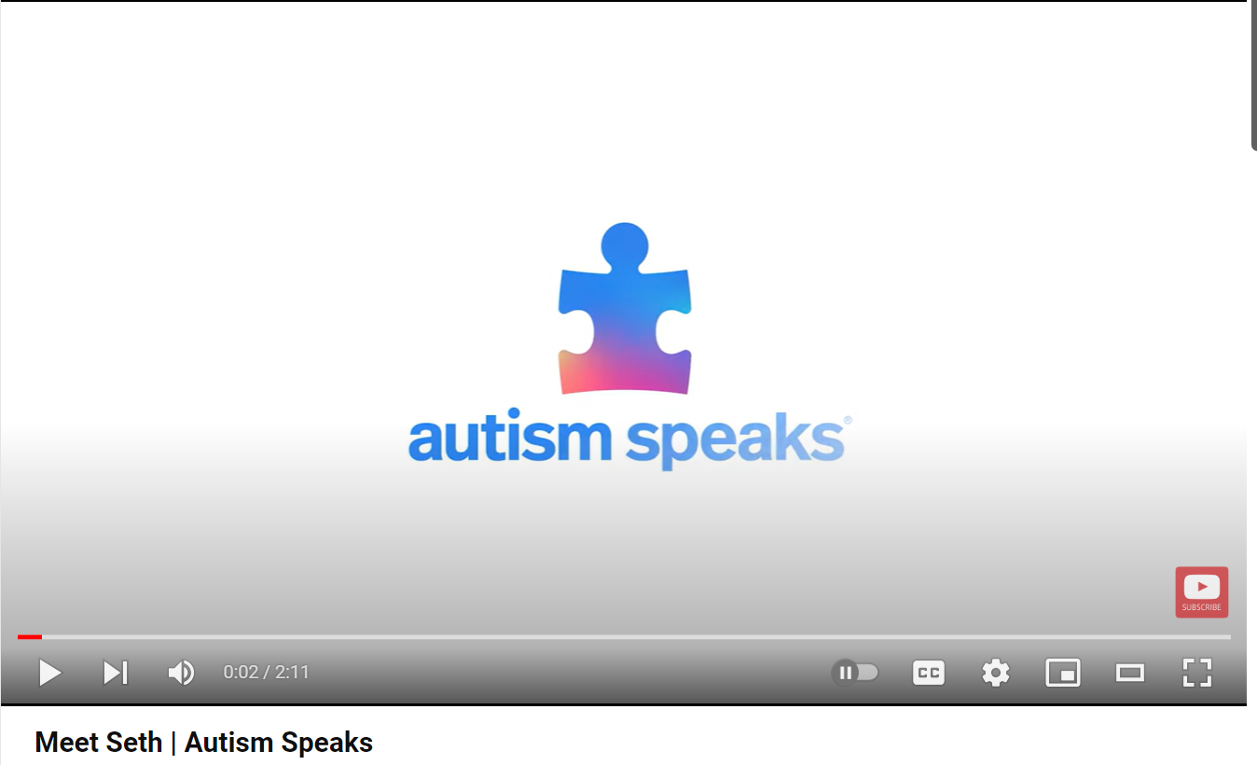
Getting to know individuals with ASD
Notes:
Meet Seth | Autism Speaks (youtube.com)

Slide 9
Autism Spectrum Disorder
Symptoms develop as early as the first year of life and typically become more apparent by age 2.
Life-long neurodevelopmental condition with delays or challenges that occur throughout development and can affect a variety of skills (social, emotional, communication, cognitive):
  Social communication/social interaction
  Restricted interests and repetitive behaviors

Slide 10
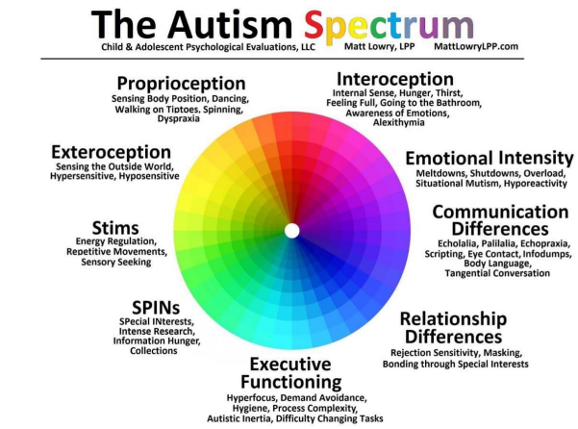

Slide 11
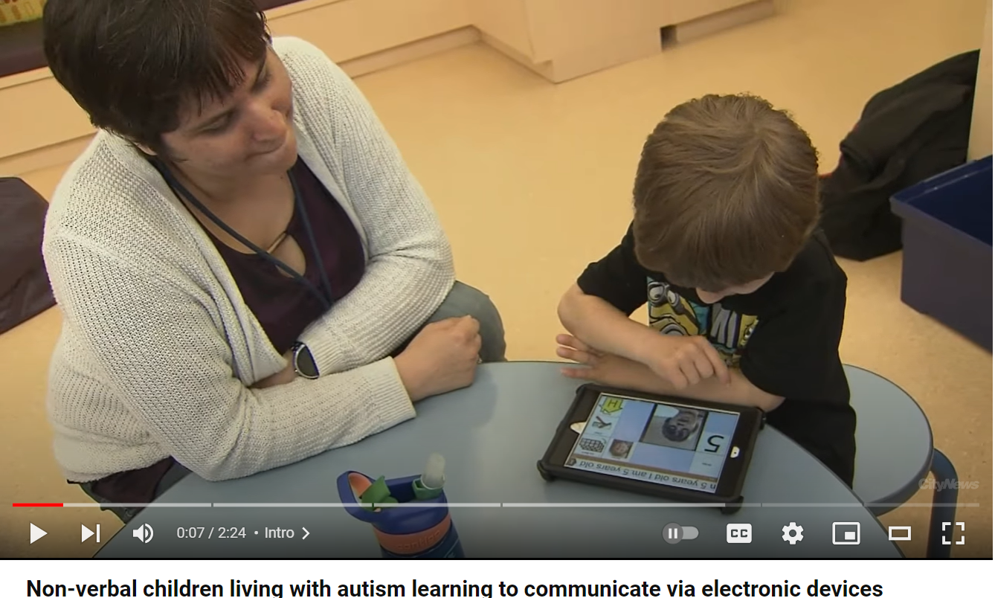
Communicating via electronic devices
Notes:
https://www.youtube.com/watch?v=BPo1H1eMU9k

Slide 12
Supporting Communication

Slide 13
Communication styles
People who use verbal language
  Tone
  Affect
  Eye contact
  Incorrect grammar
  Poor conversational skills
  Social cues ignored

Slide 14
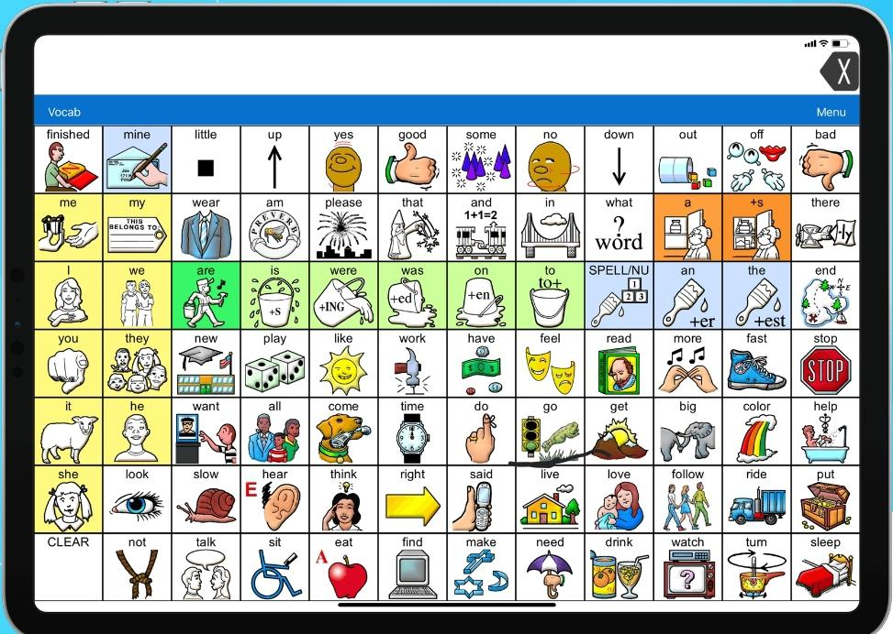
Non-verbal Communication
Alternative and Augmentative Communication
“AAC Device”

Slide 15
Communication strategies
Slow down/Allow processing time
Make it visual
Make it personal
Short and manageable questions and instructions
Say “what to do” rather than “what not to do” – Keep it positive
Avoid confusing language

Slide 16

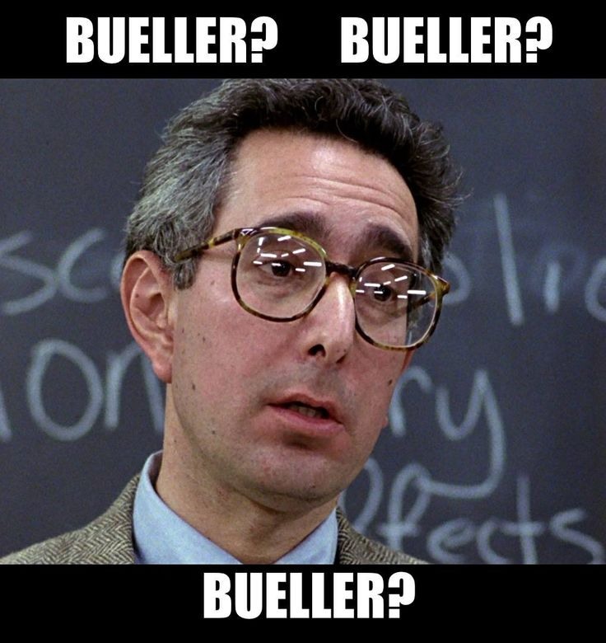
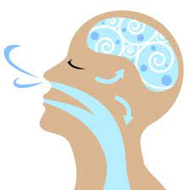
Slow down/allow processing time
Add pauses at the end of the sentence or thought.
Take a breath.
Go slower than you think.
Don’t be afraid to repeat yourself.

Slide 17
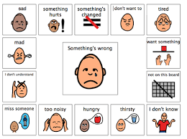
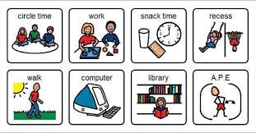
Make it visual

Slide 18
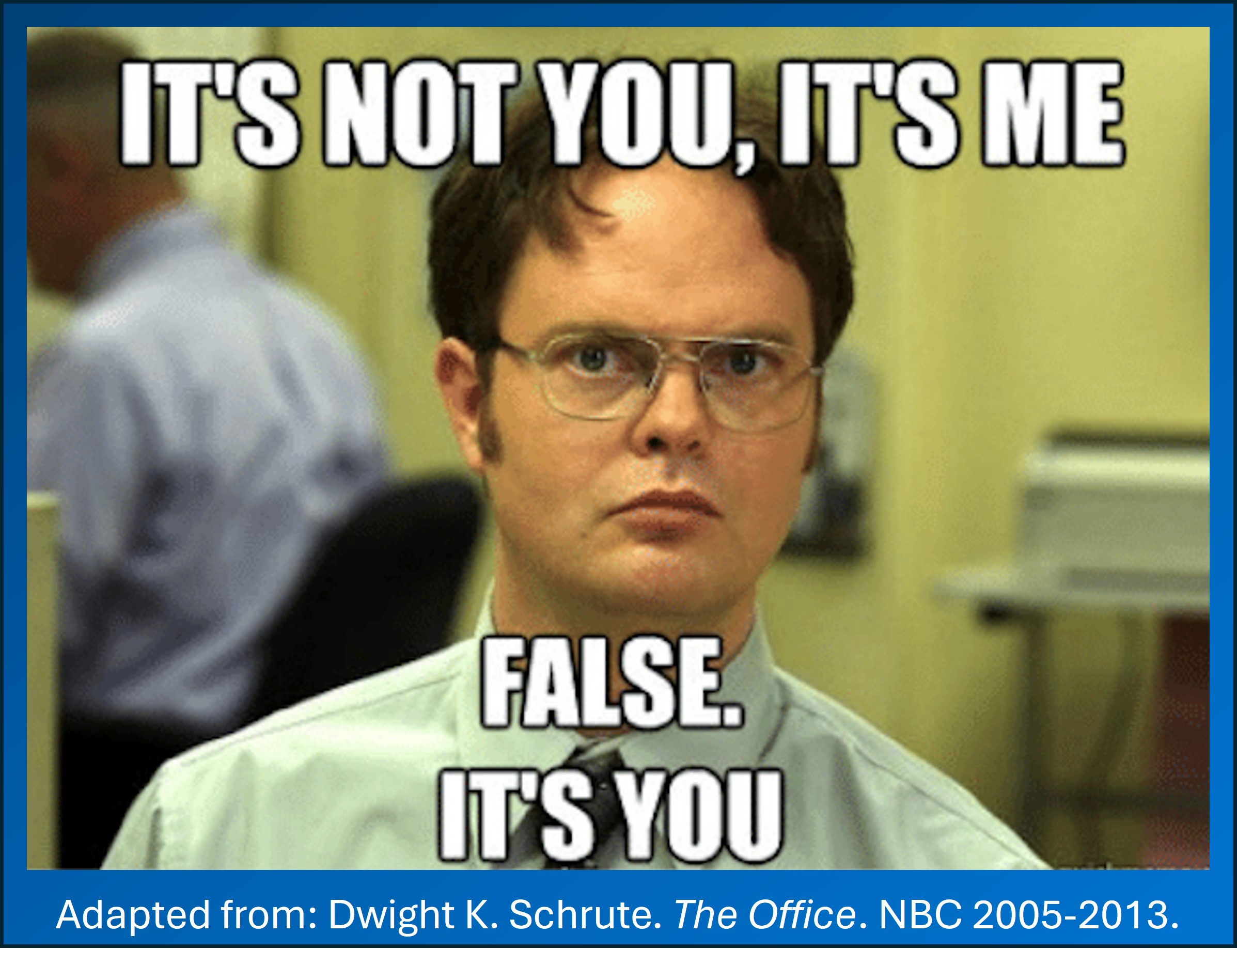
Make it personal
Notice something about the individual,
relate to it
Connect on their level

Slide 19


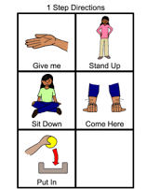

How should we be giving instructions?
Short and manageable questions and instructions

Slide 20
Keep it positive
Instead try
That’s not a choice/option
It doesn’t work that way (redirecting to an object)
Let’s do something else
Avoid saying
No
Can’t
Don’t

Slide 21
Avoid confusing language
Avoid saying | Try saying
Once in a blue moon | not often
See eye to eye | I agree
Ten out of ten | I recommend this
Two heads are better than one | Let’s work together
Piece of cake | This is easy
Under the weather | Not feeling well
Bite the bullet | Just do it

Slide 22
Accommodating Sensory Differences

Slide 23
Sensory processing
Sensory processing refers to: how our nervous system receives information from our senses (sight, sound, touch, taste, smell, and movement) and turns that information into responses.
How we process sensory information impacts how we experience the world around us.
Neurodivergent individuals may process sensory information differently
  Hyper reactivity
  Hypo reactivity

Slide 24
Proprioception
Discussion:
How might this impact processes in an emergency?
The body's ability to sense its own position, movement, and orientation in space without relying on vision. This sense is crucial for coordinating movements, maintaining balance, and controlling muscle activity.
Dysfunction of the proprioceptive system can lead to problems with coordination, balance, and movement control.
Notes:
Deficits in this area may make it overwhelming to navigate a busy museum environment. Bumping into others/exhibits around them. Using materials with too much force.

Slide 25
Tactile
Discussion:
How might this impact processes in an emergency?
Tactile sensory processing refers to the brain's ability to interpret information received from the sense of touch. It involves the detection, discrimination, and interpretation of various tactile stimuli, including pressure, vibration, texture, temperature, and pain.
Dysfunction in tactile sensory processing can lead to hypersensitivity (heightened sensitivity to touch), hyposensitivity (reduced sensitivity to touch), or difficulties in processing tactile information.
Notes:
These sensory processing disorders may manifest as sensory seeking or avoidance behaviors, difficulties with fine motor skills, and challenges with social interactions. Difficulty tolerating when clothing gets wet in water area, difficulty transitioning away from water area, hesitancy to touch materials

Slide 26
Auditory
Discussion:
How might this impact processes in an emergency?
Auditory sensory processing refers to the brain's ability to interpret and make sense of sounds received by the auditory system. It involves the detection, discrimination, localization, and interpretation of various auditory stimuli.
Auditory processing is crucial for understanding spoken language, recognizing sounds, and navigating the acoustic environment.
Notes:
Individuals with auditory hypersensitivity may use noise canceling headphones to assist in navigating loud or busy environments. Sensory seeking individuals may make loud noises unrelated to the activity they are participating in.

Slide 27
Visual
Discussion:
How might this impact processes in an emergency?
Visual sensory processing refers to the brain's ability to interpret and make sense of visual information received by the visual system.
Visual processing is essential for perceiving the surrounding environment, recognizing objects and faces, navigating space, and performing visually guided tasks.
Notes:
Individuals with auditory hypersensitivity may use noise canceling headphones to assist in navigating loud or busy environments. Sensory seeking individuals may make loud noises unrelated to the activity they are participating in.

Slide 28
Taste and Smell
Discussion:
How might this impact processes in an emergency?
The sense of smell, also known as olfactory processing, involves the perception and interpretation of smells by the brain. The sense of smell is one of the primary ways we interact with their environment, influencing behaviors, emotions, and memories.
Notes:
Individuals with auditory hypersensitivity may use noise canceling headphones to assist in navigating loud or busy environments. Sensory seeking individuals may make loud noises unrelated to the activity they are participating in.

Slide 29
Activities that are alerting to the nervous system
Noises that have quick changes in cadence, pitch or tone
Movements that include quick changes in head position or body rotation/spinning
Quick changes in visual stimuli (e.g., color, light)
Light touch (versus deep pressure)

Slide 30
Activities that are calming to the nervous system
Deep pressure
Linear movement
Low, slow and predictive sounds
Slow moving visual input

Slide 31
Common fine motor challenges
The ability to make precise movements with the small muscles in the hands, fingers and wrists
  Grasp and release
  Pinching
  Holding utensils
  Coloring/writing/drawing
  In-hand manipulation

Slide 32
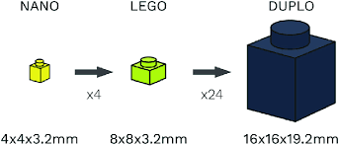

Fine motor adaptations
USING LARGER OBJECTS
SMALLER WRITING TOOLS

Slide 33
Consideration of social skills
A hallmark of ASD is difficulty with reciprocal social interaction, which can present differently in each individual
  How would you support an individual who was talking loudly and excessively during an emergency scenario?
  In contrast, how would we support someone who was smiling but shrinking back from the crowd?
Notes:
Terms like neurodivergent were introduced in the 1990s by autistic sociologist Judy Singer as an alternative to deficit-based language, such as “disorder.” Singer highlighted notable strengths of many individuals in the autistic population that include abilities to focus, recognize patterns, and remember factual information.

Slide 34
Responding to challenging behaviors
Offer support to caregiver in transitioning to a quiet space
“BUT” transitions can be very challenging
What can we do right here right now to help this individual calm down
When possible, guide the family or individual to a quiet, less stimulating space. Privacy would be an added bonus!
Offer visual supports, timers
Use a calm, neutral tone and expression. Avoid panic or anger yourself!
Offer a glass of water to the distressed individual and their caregiver
Move other individuals away to give space and privacy, especially if the individual is becoming self injurious, loud, or aggressive.

Slide 35
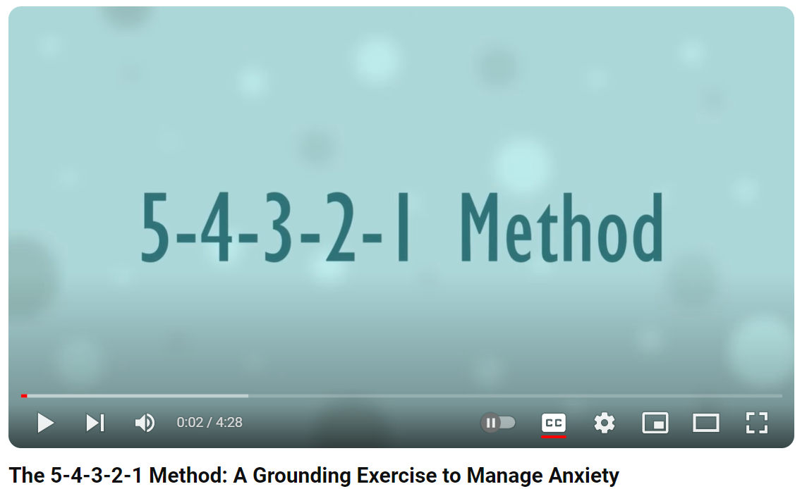
Emotion regulation strategy
Notes:
https://www.youtube.com/watch?v=30VMIEmA114

Slide 36
Thank you.

