Slide 1
Richard Lippert, MBA, CSP, MEPP, NRP, CHEP
Regional Manager, Healthcare Emergency Management, Public Health Management Corporation
Before the First Call – From Chaos to Coordination: Interagency Communication Lessons from the Butler Rally
“Communication doesn’t fail because radios don’t work.
It fails because systems don’t align.”
Notes:
Title: "Before the First Call: Interagency Communication Lessons from the Butler Rally"
Description: Communication failures don’t begin on the radio—they start long before the incident. Using the Butler Rally shooting as a real-world case study, this session examines how planning, assumptions, and roles shape interagency communication and ultimately influence outcomes.
reveal it through failure - connect it to decisions - tie it to communication

Slide 2
Theme Of The Day
Coordination
Communication
Collaboration

Slide 3

Personal Responses
“Circumstances don’t create character. They reveal character.”
  -Zig Ziglar

Slide 4
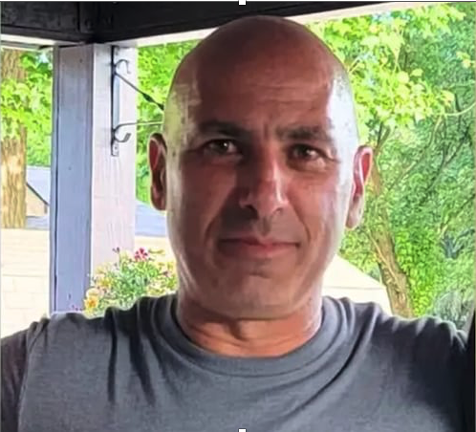



Slide 5
First notifications
What each agency thought was happening
3 July
(Wednesday) Rumor of potential event
5 July
(Friday) Notification and scheduling of meeting for Monday
8 July
(Monday) 1300 meeting at Allegheny County 911
9 July
(Tuesday) On site meeting with Secret Service followed by meeting at PSP Butler
Of note Secret Service shared information from Norfolk event
11 July
(Thursday) Onsite meeting with Public Safety Agencies
12 July
(Friday) On site set up of County Command Vehicle/State Assets
13 July
Trump Rally
19 July
Corey’s Funeral
Where alignment didn’t exist
A good plan violently executed now is better than a perfect plan executed next week. – Gen. Patton
Notes:
A good plan violently executed now is better than a perfect plan executed next week.
Talk about the condensed time-line.

Slide 6
Why coalitions fail even with good people + funding
Coordination and true coalition leadership
Anchor vs. Sail concept: stability + adaptability
Notes:
Most coalitions don’t fail due to lack of funding or passion. They fail because leadership becomes unclear, inconsistent, or overly cautious.
Coordination is easy. True coalition leadership is difficult.
The ‘Anchor vs Sail’ concept matters here — leaders must stabilize during chaos while also allowing movement and flexibility. Too rigid, and you break. Too loose, and you drift.

Slide 7
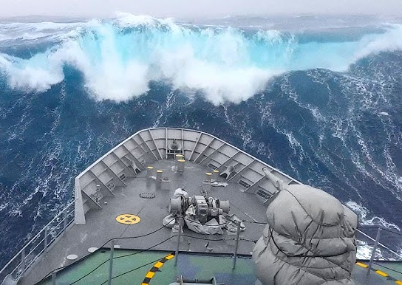
Notes:
The Anchor and the Sail
Imagine a ship caught in building waves. The crew panics and drops the anchor — the ship stops drifting, but the storm keeps raging. They feel safer, but they’re not moving forward.
So they cut the anchor and raise the sail. Now they’re flying — but with no stability, every wave throws them off course.
Strong coalitions don’t choose between stability and flexibility — they need both. The leader’s job is knowing when to drop the anchor and when to raise the sail.
The Anchor: Stability
The anchor represents what must stay firm no matter the storm.
This is:
Core mission and purpose
Governance structure and decision rules
Values and behavioral expectations
Trust, relationships, and consistency
Role clarity and accountability
Anchors create:
Psychological safety
Predictability
Credibility
Confidence during chaos
Without an anchor, coalitions drift, fracture, or chase funding instead of purpose.
The Sail: Adaptability
The sail represents movement, evolution, and responsiveness.
This is:
Innovation and new approaches
Shifting strategies during crises
Adjusting to funding changes
Evolving stakeholder needs
Real-time problem-solving
Sails allow:
Speed
Responsiveness
Creativity
Growth
Without sails, coalitions become rigid, outdated, and resistant to change.
The Leadership Tension
Deploying both at the right time is the art.
Too much anchor:
Bureaucracy
Stagnation
Fear of change
Slow response
Too much sail:
Mission drift
Chaos
Inconsistent direction
Burnout
Great leaders constantly ask:
What must remain fixed here?
What needs to evolve?
Real-World Coalition Application
During Crisis:
Anchor: Command structure, protocols, communication standards
Sail: Rapid operational decisions, creative solutions, emergent needs
Between Crises:
Anchor: Relationship-building, governance, long-term strategy
Sail: New partnerships, updated frameworks, future planning
Simple Leadership Takeaway
The most effective coalition leaders know:
When to steady the ship
When to let it move
And how to communicate the difference clearly
Stability gives people confidence.
Adaptability gives them survival.
Strong coalitions master both.

Slide 8
The anchor isn’t there to stop progress.
The sail isn’t there to replace structure
Notes:
The Anchor and the Sail
Imagine a ship caught in building waves. The crew panics and drops the anchor — the ship stops drifting, but the storm keeps raging. They feel safer, but they’re not moving forward.
So they cut the anchor and raise the sail. Now they’re flying — but with no stability, every wave throws them off course.
The captain finally learns the truth:
The anchor isn’t there to stop progress.
And the sail isn’t there to replace structure.
The anchor keeps the ship from being lost.
The sail takes it where it needs to go.
Coalitions are the same.
Too much anchor and you stagnate.
Too much sail and you drift.
Leadership is knowing when to ground your people…
and when to trust them to move.

Slide 9
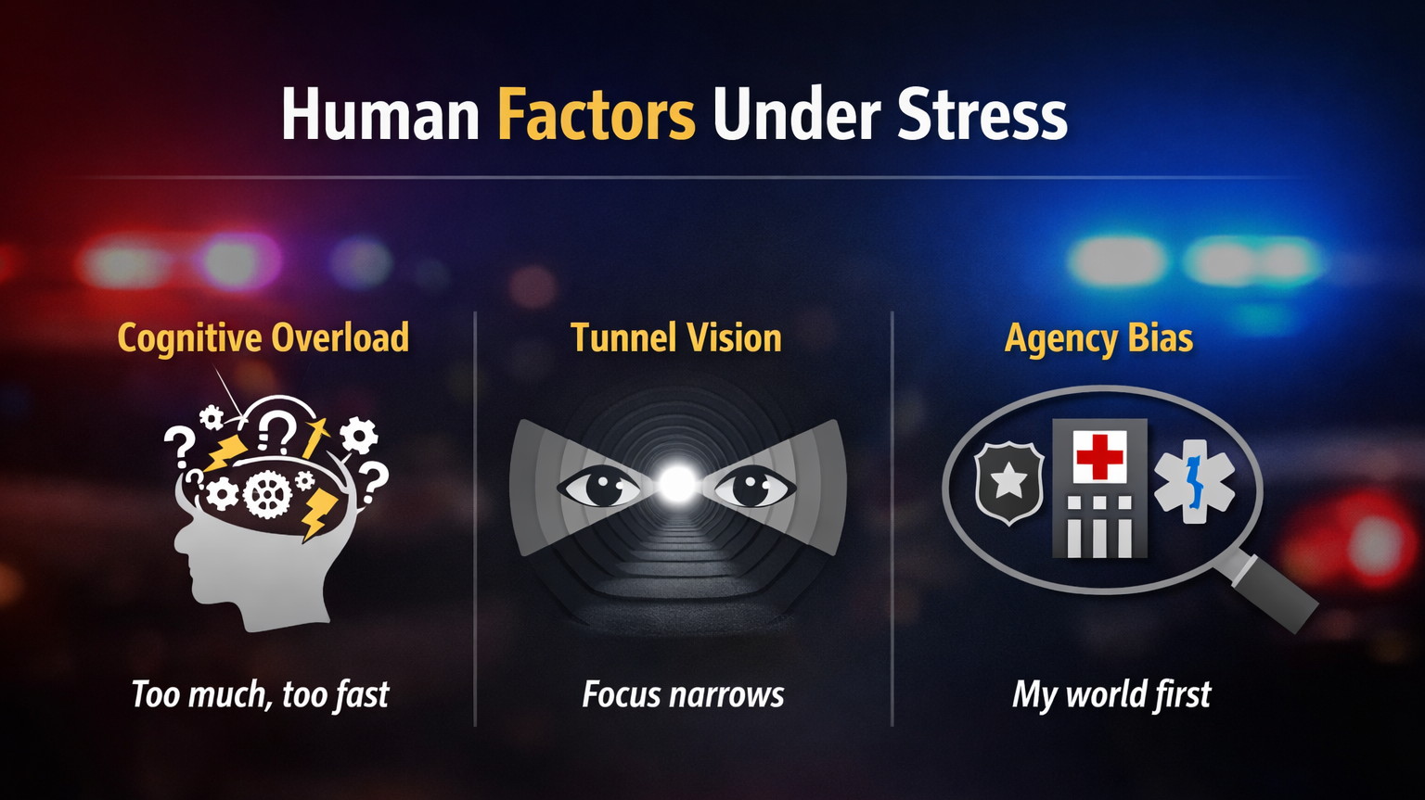

Slide 10
Relationships
Pennsylvania State Police (PSP)
Secret Service
Local EMS
Local Fire
Butler Memorial Hospital (Independence Health)
Health Care Coalition (HCSWPA)
EMS West
AHN
UPMC
SMAT Team
VA Hospital
Surrounding Counties- Westmoreland, Lawrence, Armstrong, Allegheny, Mercer
ESU/District Attorneys office
Local Police
CISM Teams

Slide 11
Information Flow Failure
Who knew what—and when?
Delayed / conflicting intel
“Parallel realities”
Notes:
This is why this failed at Butler!

Slide 12
The Coalition Leadership Reality
Unique challenges:
No direct authority
Competing organizational priorities
Volunteer fatigue
Grant-driven survival cycles
The leadership paradox: influence without control
Notes:
Unlike traditional organizations, coalitions function without direct authority. People serve voluntarily, cooperation fluctuates, and funding often dictates momentum. You are constantly balancing diplomacy with direction. Leadership here isn’t about enforcing compliance — it’s about cultivating commitment.
Radios vs relationships
Planned vs practiced coordination

Slide 13

Core Leadership Models That Hold Up
Adaptive Leadership
Servant Leadership
Systems Leadership
Distributed Leadership
Notes:
These models aren’t buzzwords – they’re survival tools. Adaptive Leadership helps you lead when no roadmap exists. Servant Leadership keeps ego out of the room. Systems Leadership forces us to think beyond our own agency. Distributed Leadership reminds us that coalitions thrive on shared responsibility. These theories weren’t proven in classrooms — they were proven in moments when decisions mattered. When leaders stopped trying to control outcomes and started shaping environments, coalitions became more resilient and sustainable.

Slide 14

Adaptive Leadership
Leading people through challenges where there is no clear playbook.
Notes:
These are not technical problems with technical fixes.
Adaptive leadership is about helping people change behaviors, not just procedures.
In coalitions, the leader’s role is to surface the tough issues others avoid.
You’re not solving the problem — you’re guiding people through uncertainty.
Tie to coalitions:
Perfect for multi-agency dynamics where no one owns the whole problem.
Requires comfort with discomfort and tension.
Ronald Heifetz

Slide 15

Systems Leadership
Leading with awareness that everything is connected.
  If you only fix your own piece, the system still fails.
Notes:
No action exists in isolation — decisions ripple across agencies.
Coalition leaders must see beyond their own lane.
When one system is stressed, all feel it.
Tie to coalitions:
Helps prevent silo thinking.
Encourages cross-sector solutions instead of turf protection.
This is a systems problem—not a communication problem
Agencies weren’t wrong
They were operating in different systems
No shared operating picture
Peter Senge

Slide 16
Authority & Decision Ambiguity
Who was actually in charge?
Formal vs informal leadership

Slide 17
Communication Alignment Map
🏛 EM
Incident
🚑 EMS
🏥 Hospital

Slide 18

Decision Trigger Points
Planning
Initial
Escalation
Unified Command

Slide 19
Decision Trigger Points
Planning
Initial Escalation
Unified Command

Slide 20

Communication Drills
❌ Radio checks
❌ Equipment tests
✅ Shared updates
✅ Decision communication

Slide 21

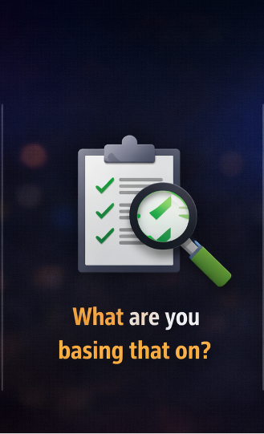


Slide 22
Strategic Anchors of High-Functioning Coalitions
Governance clarity (roles, decision rights, behavioral norms)
Decision authority mapping: Who decides vs who advises
Participation expectations: What active membership actually means
Role of chair/lead agency: When facilitation becomes leadership
Accountability mechanisms: How to keep commitments visible
Vision alignment vs. mission creep
Trust economies (credibility = currency)
Decision-making frameworks (consensus vs. command moments)
Notes:
Strong coalitions have clarity: who decides what, when, and how. They distinguish between participation and influence. They treat trust like currency — because without it, nothing moves forward.
Governance clarity (roles, decision rights, behavioral norms)
Decision authority mapping: Who decides vs who advises
Participation expectations: What active membership actually means
Role of chair/lead agency: When facilitation becomes leadership
Accountability mechanisms: How to keep commitments visible
Vision alignment vs. mission creep
Trust economies (credibility = currency)
Decision-making frameworks (consensus vs. command moments)

Slide 23
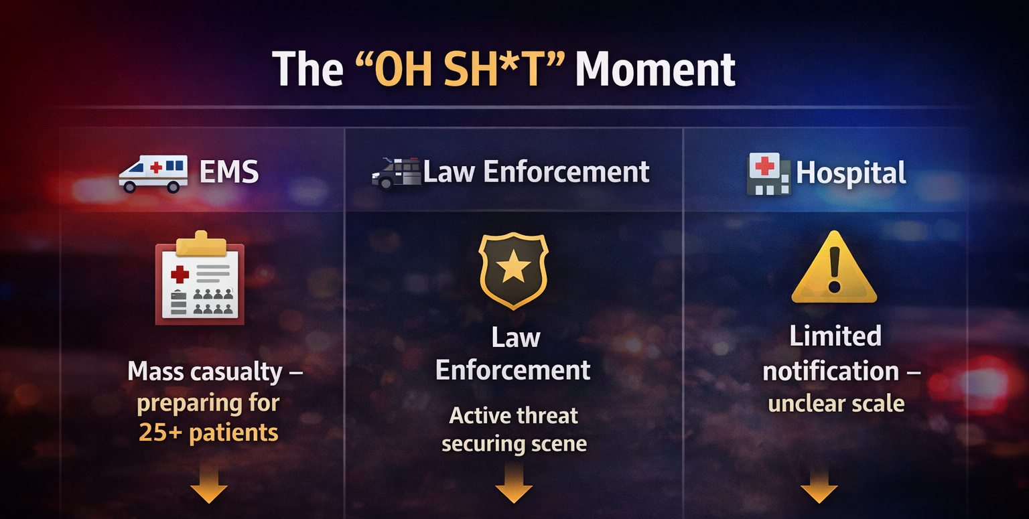
Notes:
None of them knew the difference!

Slide 24
🔥 The “OH SH*T” Moment
Communication failure had real consequences
Notes:
“Would your coalition have done better?”
“At this moment, EMS believed X
Law enforcement believed Y
And no one knew the difference”

Slide 25
Anchors That Keep Coalitions Standing
Strategy is the ongoing discipline of choosing what the coalition will not do!
Clear decision rules ( - not just group discussion)
Defined behavioral expectations
Succession planning before crisis
Strategic friction — not fake harmony
Leadership presence between disasters, not just during them
Annual strategic refresh
Notes:
“Strategy is the ongoing discipline of choosing what the coalition will not do.”
These actually make the difference:
Clear expectations, healthy dissent, and visible leadership presence sustain engagement beyond crisis. The coalition must feel guided even during quiet periods.

Slide 26
Leadership Tools That Aren’t Sexy — But Save You
Annual review of bylaws, roles, and meeting structure
Power-mapping: Who truly influences the room?
Coalition health check pulse tool
Crisis vs. stability decision matrix
Engagement reset strategies
Notes:
Not glamorous, but essential. Understanding who drives decision-making and when to recalibrate engagement prevents long-term erosion
Annual review of bylaws, roles, and meeting structure
Power-mapping: Who truly influences the room?
Coalition health check pulse tool
Crisis vs. stability decision matrix
Engagement reset strategies

Slide 27
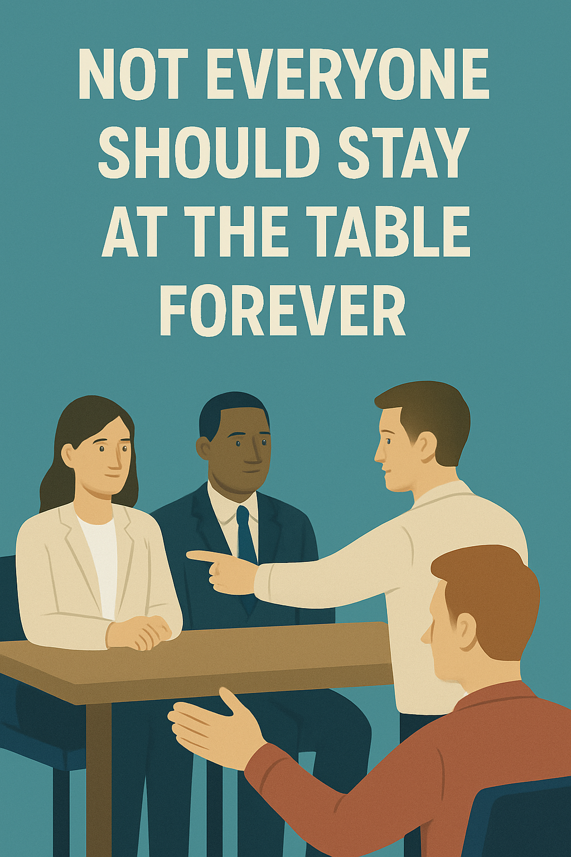
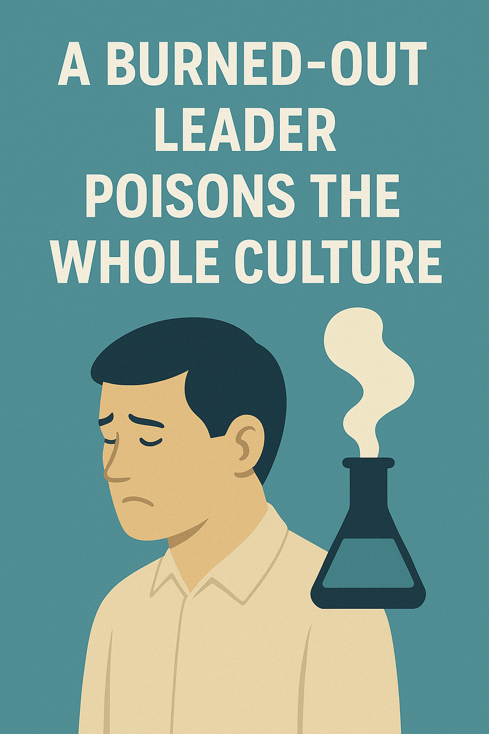
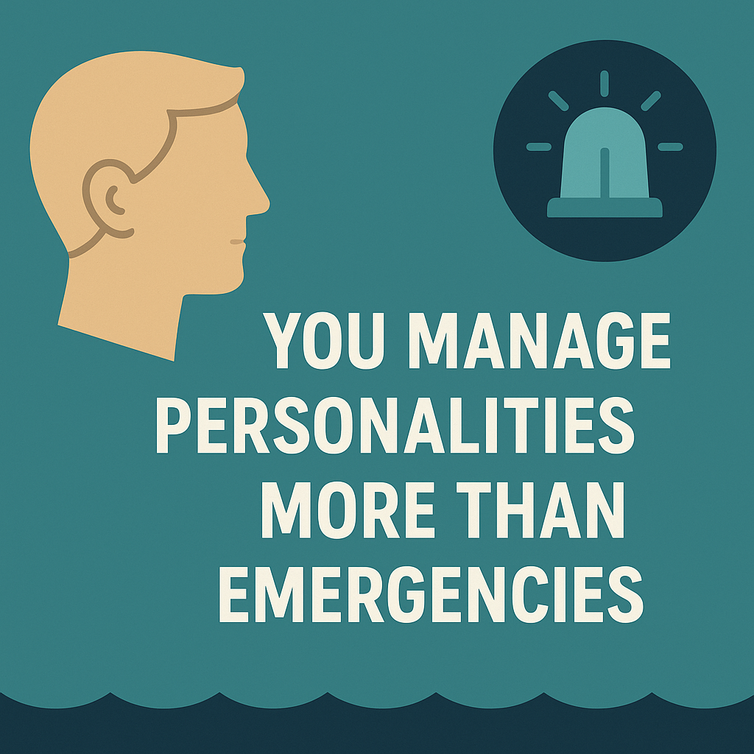
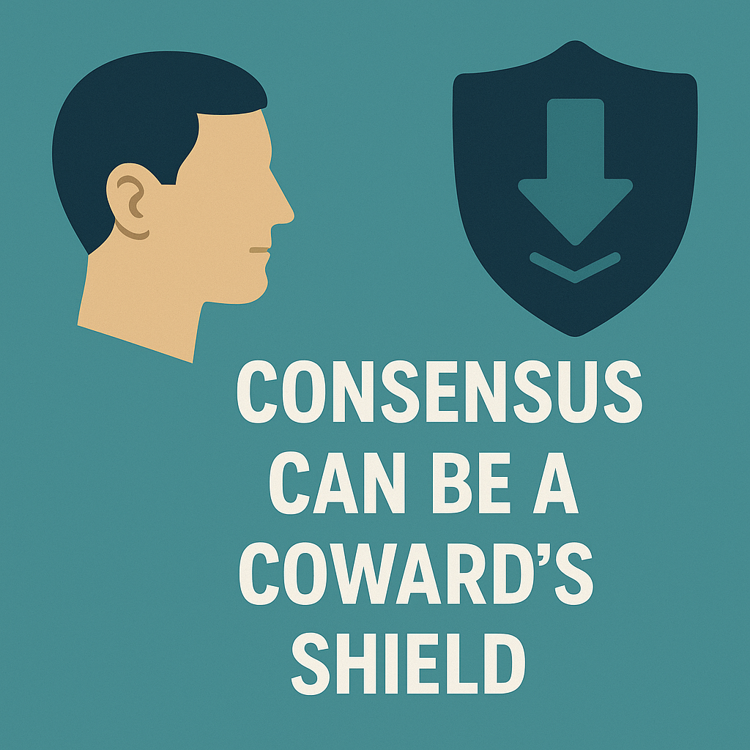
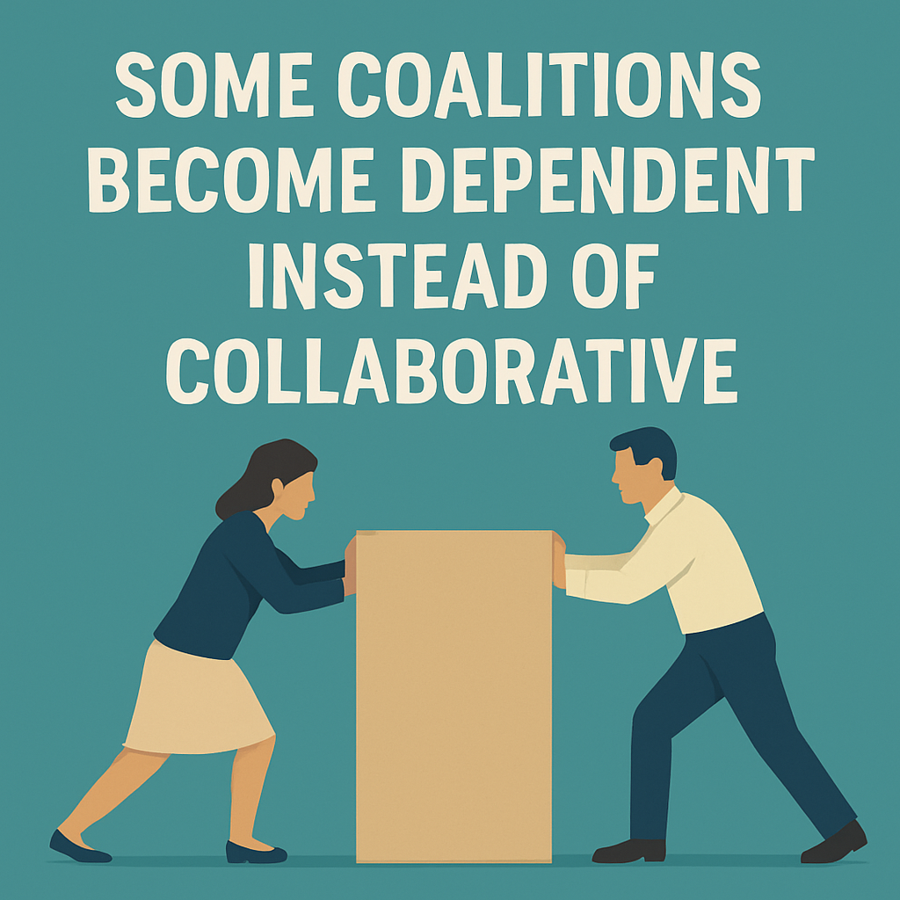
Notes:
Off-the-Wall but Real Leadership Truths
And the hardest one:
Sometimes the greatest leadership move is disrupting comfort.
Consensus feels safe but often delays progress. Some partners drain more energy than they add. And sometimes, leadership requires disruption — not comfort.

Slide 28

Lessons Learned
Clarified roles prevented future conflict
Alignment exercise reset the mission
Open conflict → structured agreements
Board retreat
Notes:
Real-World Applications
Moments of success and failure both offer value. Case examples from board retreats and coalition resets show that transformation happens when leadership becomes intentional instead of reactive.
Coalition-building case examples:
Trust repair moments
Conflict navigation
Coalition reset strategies
Clarified roles prevented future conflict
Alignment exercise reset the mission
Open conflict → structured agreements

Slide 29
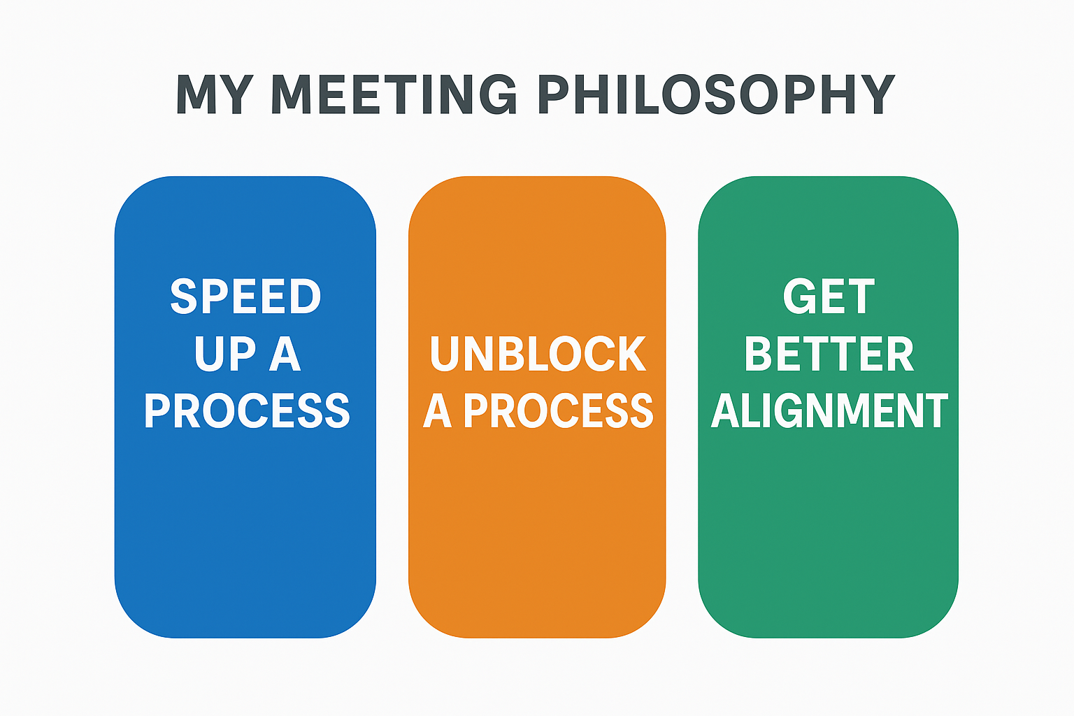
Notes:
Speed Up a Process
Unblock a Process
Get Better Alighnment

Slide 30
In a crisis, communication is the anchor.
If it drifts—everything drifts.
Notes:
Clarity over consensus
Structure over assumptions
Practice over plans

Slide 31
Power-Mapping: Who truly influences the room?
Power-Interest Grid
High Power + Low Interest
The Blockers or Regulators
Hospital CFO
Chief legal or compliance
County commissioners
High Power + High Interest
The Drivers
EMS Medical Director
Health system VP of EM
Key resource owner
Low
“Who is in the wrong quadrant?”
High
The Passengers
Agencies attending out of obligation
Partners who show up silently
No skin in the game
The Workhorses
EM coordinators
Public health planners
Hospital EM staff
Interest
Notes:
High Power + High Interest
What you do:
Engage early
Share planning space
Involve them in decision-making
High Power + Low Interest
What you do:
Keep informed at key moments
Anticipate concerns
Bring them in early on anything affecting cost, liability, or optics
Low Power + High Interest
“The Workhorses”
What you do:
Empower them
Give visible roles
Use them to build coalition energy
Low Power + Low Interest
“The Passengers”
What you do:
Keep lightly informed
Don’t over-invest time
Reassess whether they need to stay at the table

Slide 32

Anchoring the Future
Redefining success in coalition leadership
Call to action: Lead with intention, not position
Strong coalitions aren’t built on funding.
  They are built on courage, clarity, and uncomfortable conversations.
Leadership isn’t about being liked.
  It’s about keeping the anchor steady when the storm hits.
Notes:
Coalitions don’t collapse during disasters.
They collapse quietly in the months between them.
They weaken when leadership avoids tension.
They erode when comfort replaces courage.
They drift when no one is willing to steer.
You are not just coordinating agencies.
You are shaping relationships, influencing culture, and determining whether your coalition rises when it matters most.
The real measure of your leadership won’t be the meeting you run.
It will be the trust that exists in the room when everything goes sideways.
So here’s the question to take home with you:
Are you leading a coalition that gathers…
or one that actually stands together when the ground shakes?
Because when the next crisis hits, your coalition won’t rise to the occasion.
It will fall to the level of the leadership you’re willing to show today.

Slide 33

Takeaway
Anchor what matters. Adapt when it counts. Lead with clarity.
Notes:
“What we saw at Butler wasn’t a radio problem.
It wasn’t a technology problem.
It was a shared understanding problem.”
“Different agencies… operating with different pictures…
making decisions that made sense individually—but didn’t align collectively.”
“And by the time that shows up on scene—it’s already too late.”
(pause)
“If your agencies don’t agree on roles, expectations, and decision-making before the incident…
you’re not coordinating a response—you’re managing chaos.”

Slide 34
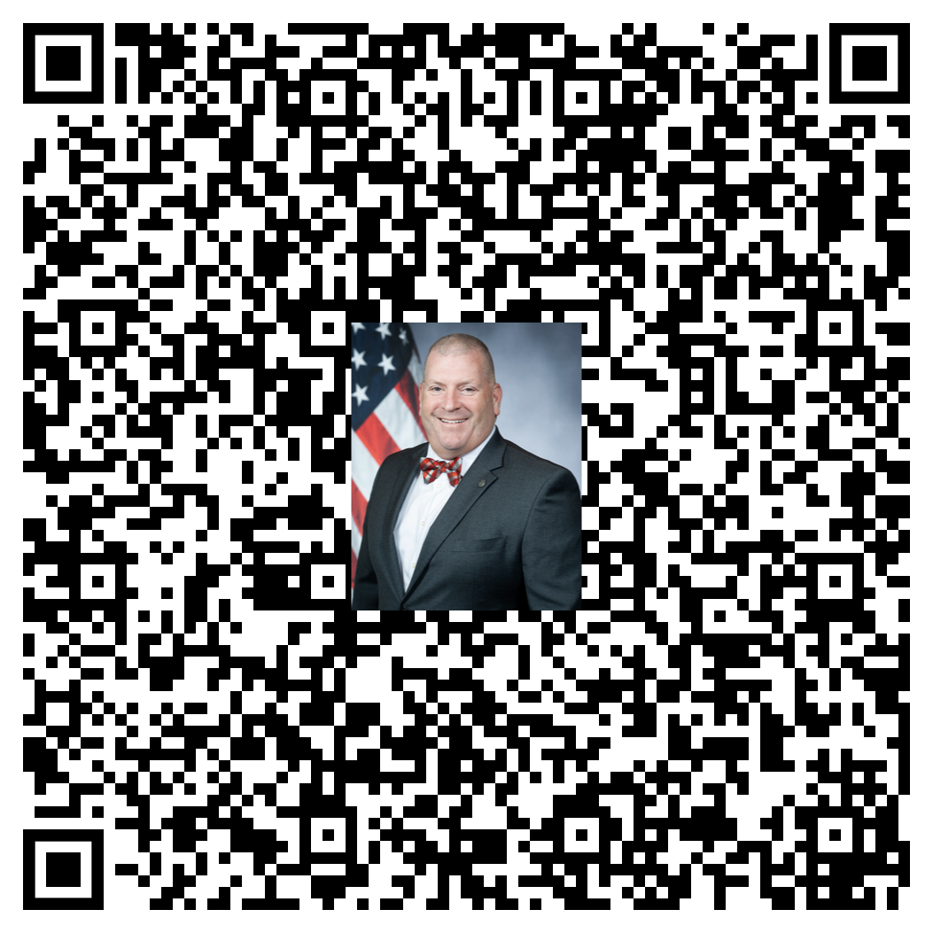
Questions
Rick Lippert
Richard.Lippert@getyouthinking.com

Slide 35
Resources (for reading)
Core Leadership Thinkers
Ronald Heifetz – Adaptive Leadership
Peter Senge – Systems Thinking
Simon Sinek – Start With Why / Trust & Culture
John Maxwell – Leadership fundamentals
Patrick Lencioni – Team dysfunction & organizational health
Brené Brown – Courageous leadership / vulnerability
Jim Collins – Level 5 Leadership
Strategy & Decision-Making
Henry Mintzberg – Organizational structure & leadership reality
Gary Hamel – Future of management
Margaret Wheatley – Leadership and systems in chaos
Crisis & Complexity
General Stanley McChrystal – Team of Teams
Atul Gawande – Healthcare systems & human factors
Notes:
The next crisis will test your coalition — but the groundwork is being laid now. Leadership isn’t proven during disasters, it’s revealed by preparation before them.

