Slide 1
Community Partnerships in Mass Casualty Response

Slide 2




4 Mass Casualty Musts
Whole Community
Unified Command
Integrated Response
Planned Recovery
2

Slide 3

Concept 1: Whole Community
Everyone has a role to play
3

Slide 4
Concept 2: Unified Command
EMS
Unified Command
Fire
Law Enforcement
Location Representative
4

Slide 5
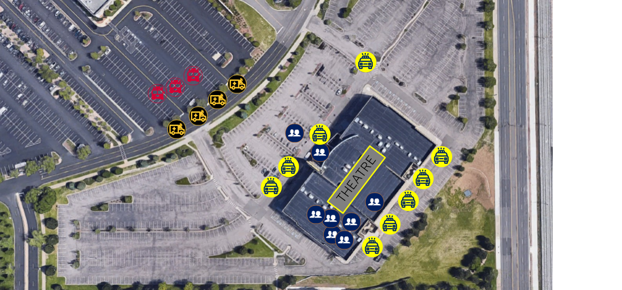
Concept 3: Integrated Response
Notes:
[1 click total]
Presenter Note: It helps to have a laser pointer on this to help people understand what they’re looking at.
Example of Integrated Response: The image here is from the 2012 ASHE incident at a movie theater Aurora, Colorado. The red vehicles are fire trucks, the orange are ambulances, the yellow are police, and the blue are victims.
The unified command structure would have helped both victims and first responders. There was no integrated response and not even radio integration.
Law enforcement took many of the victims out the back of the theater not realizing that the ambulances were all located in front of the building and across the street.
Police ended up improvising and taking victims to the hospitals themselves.
This was a surprise to the hospital who didn’t get more staff called in because they didn’t know the victims were coming and they didn’t even know a mass casualty incident had happened.

Slide 6
Concept 4: Planned Recovery
Recovery starts
TODAY
When should the recovery process start when it comes to an active shooter / hostile event?
As soon as an incident begins
Today
After an incident is over
24 hours after an incident is over
Notes:
[6 clicks total] Concept #4: Planned Recovery
Recovery is complex and it lasts the longest but yet we typically plan for it less than anything else.
[Clicks 1-5] Presenter Note: Poll the audience:
“When do you think the recovery process starts when it comes to an active shooter/ hostile event?”
As soon as an incident begins
After an incident is over
24 hours after an incident is over
Today
[Click 6]
A: Effective recovery planning must start now, and there are several aspects of recovery (immediate, early, and continued recovery) that need to be planned for.

Slide 7
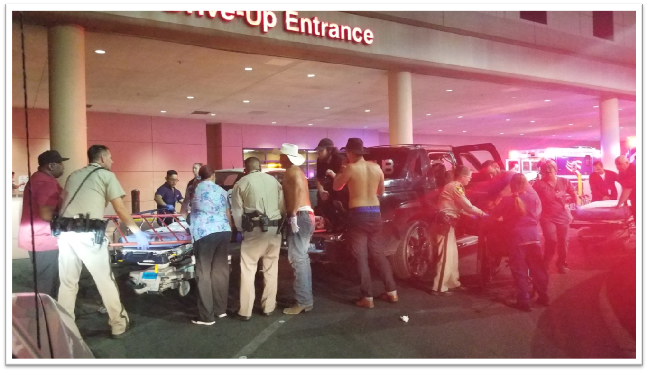
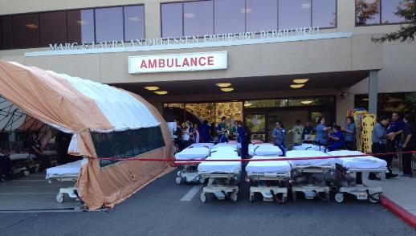
Receiving Hospitals
Communications
Victim Identification
Facility Security
Recovery Integration
7

Slide 8
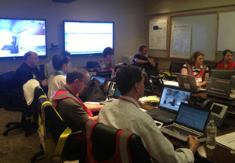
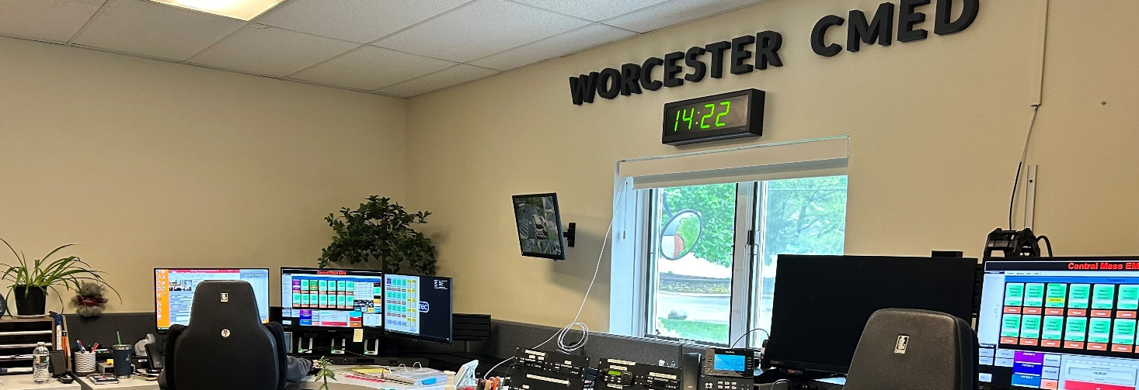
Immediate Response & Activation
Activate Hospital Incident Command System (HICS)
Initiate Emergency Operations Plan (EOP)
Establish unified command with EMS/public safety
Open communication channels

Slide 9
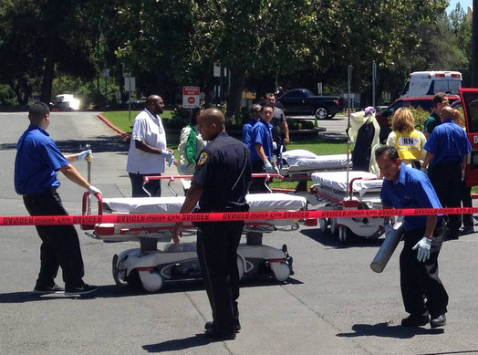
Patient Surge & Triage
Implement START/JumpSTART triage
Rapid intake and prioritization
Expand treatment areas
Track patients

Slide 10
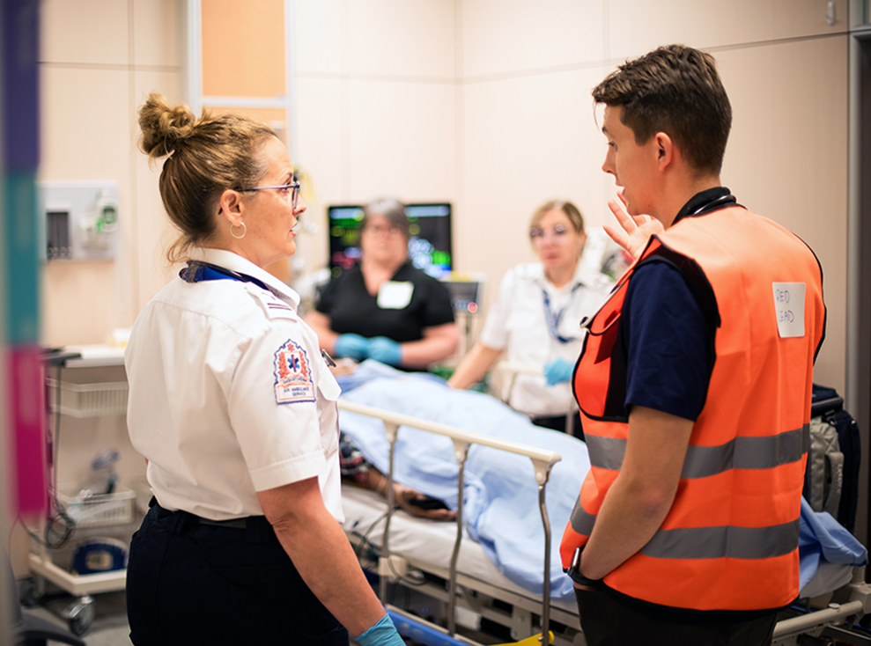
Clinical Operations
Mobilize trauma and ICU teams
Maintain care for existing patients
Activate specialty services
Prioritize life-saving interventions

Slide 11
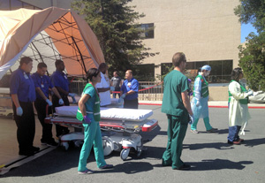
Resource & Logistics Management
Manage supplies and blood products
Coordinate staffing
Expand space and capacity
Ensure safety and utilities

Slide 12
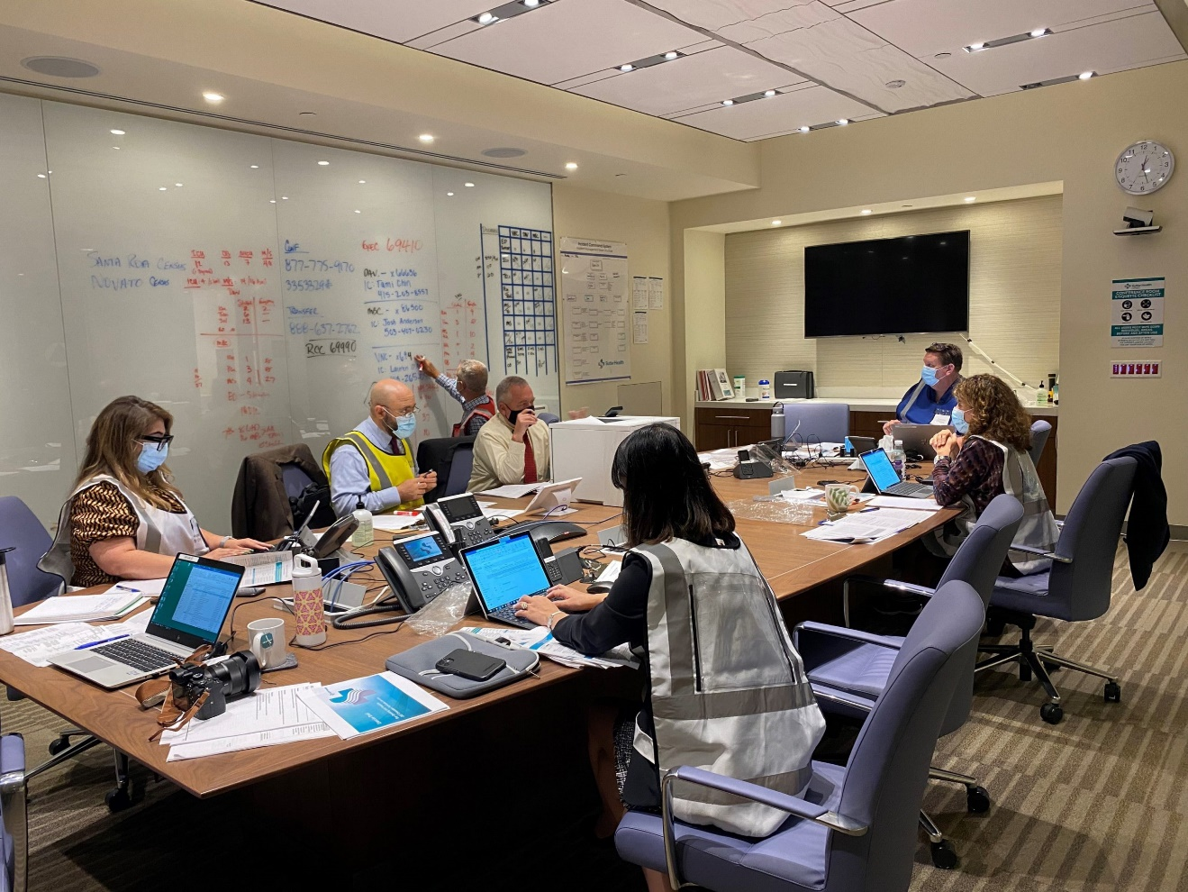
Communication & Coordination
Maintain situational awareness
Coordinate with partners
Provide staff updates
Support public information messaging

Slide 13
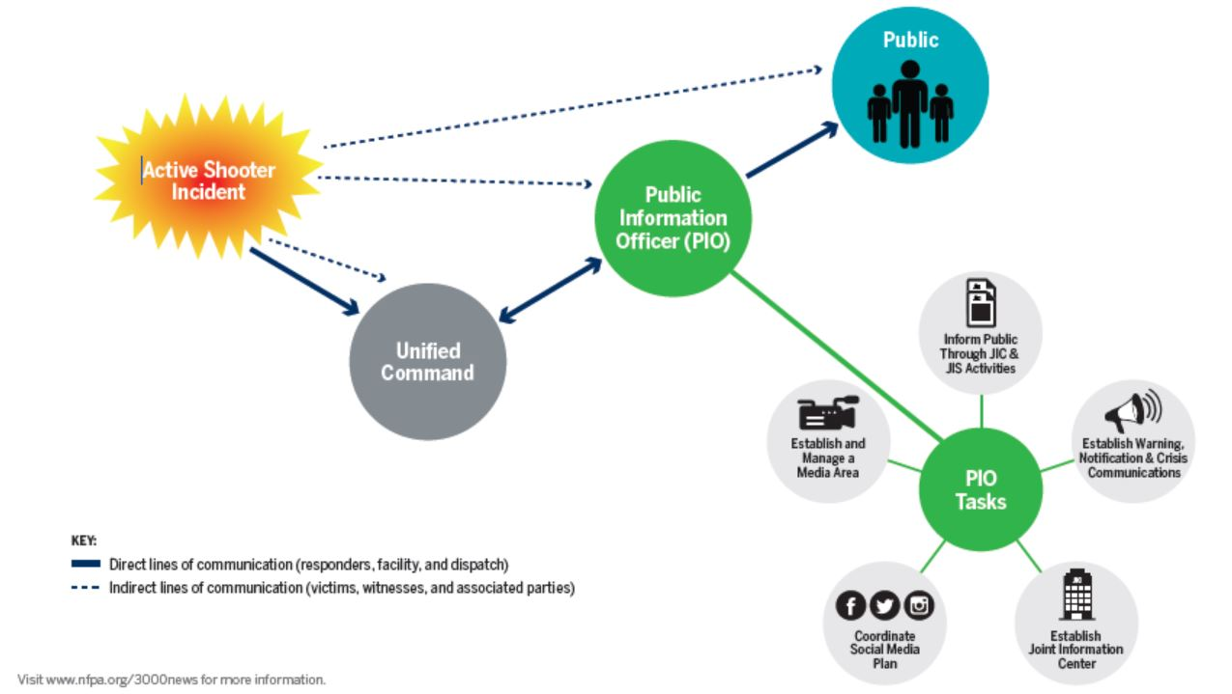
Warning, Notification, & Crisis Communications
ALERT: BALLISTIC MISSILE THREAT INBOUND TO HAWAII. SEEK IMMEDIATE SHELTER. THIS IS NOT A DRILL.
ASHE Incident
ASHE Incident
13

Slide 14
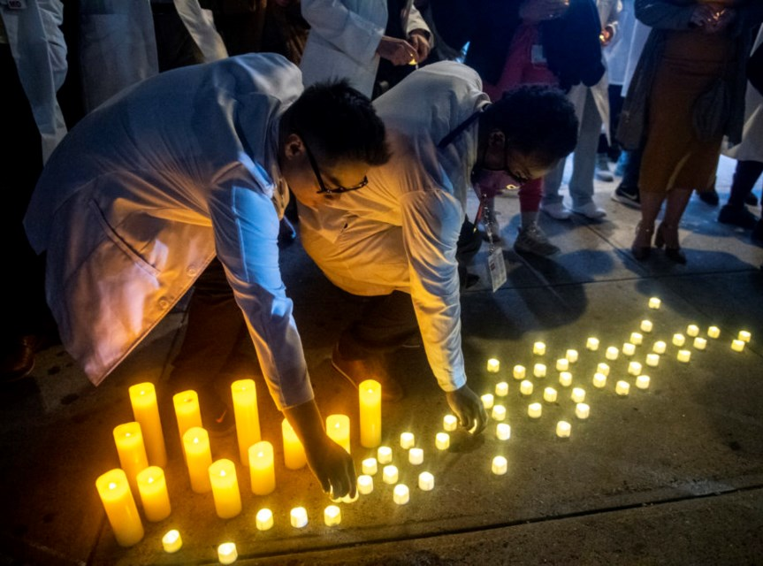
Family & Community Support
Family reunification services
Behavioral health support
Fatality management coordination
Compassionate care delivery

Slide 15
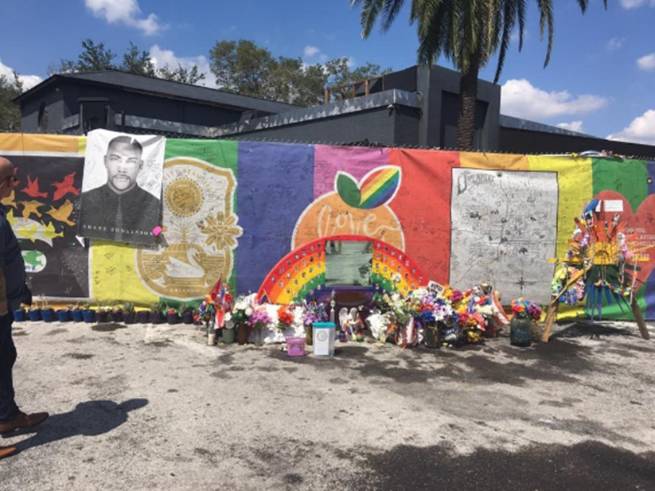
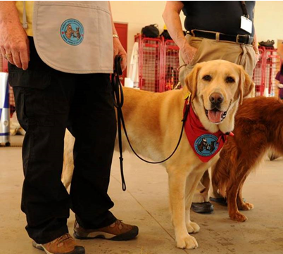
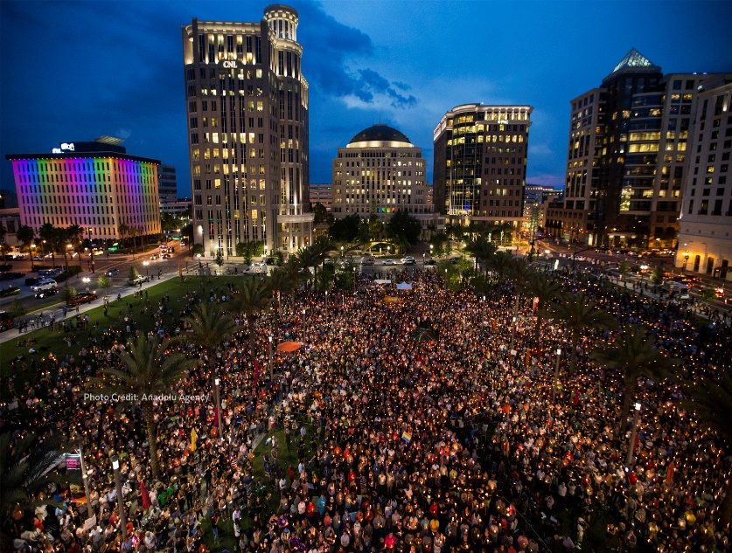

Phases of Recovery
Immediate Recovery
Early Recovery
Continued Recovery
15

Slide 16
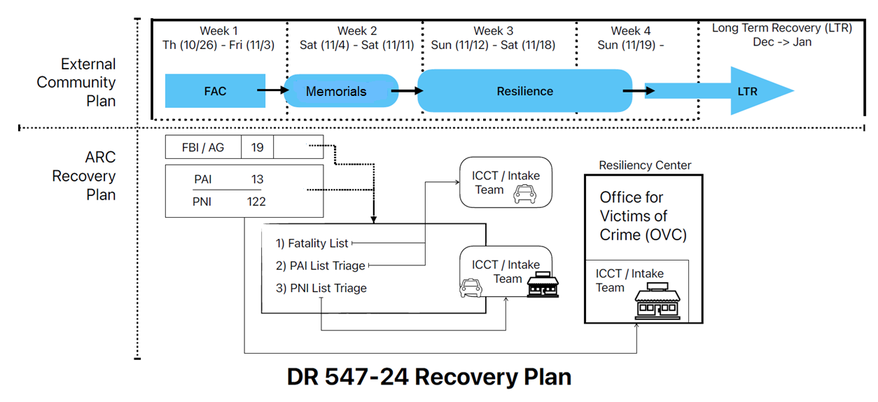
Recovery Phases in Action
Notes:
Explain ICCT – new slide?

Slide 17
Reunification Center vs Family Assistance Center
Reunification Center
Family Assistance Center
Immediate Recovery Phase
May include death notification, led by law enforcement and medical examiners, in coordination with hospitals and Red Cross.
Long-Term Recovery Phase
Provision of services and information to the family members of those killed and to those injured or otherwise impacted by the incident

Slide 18
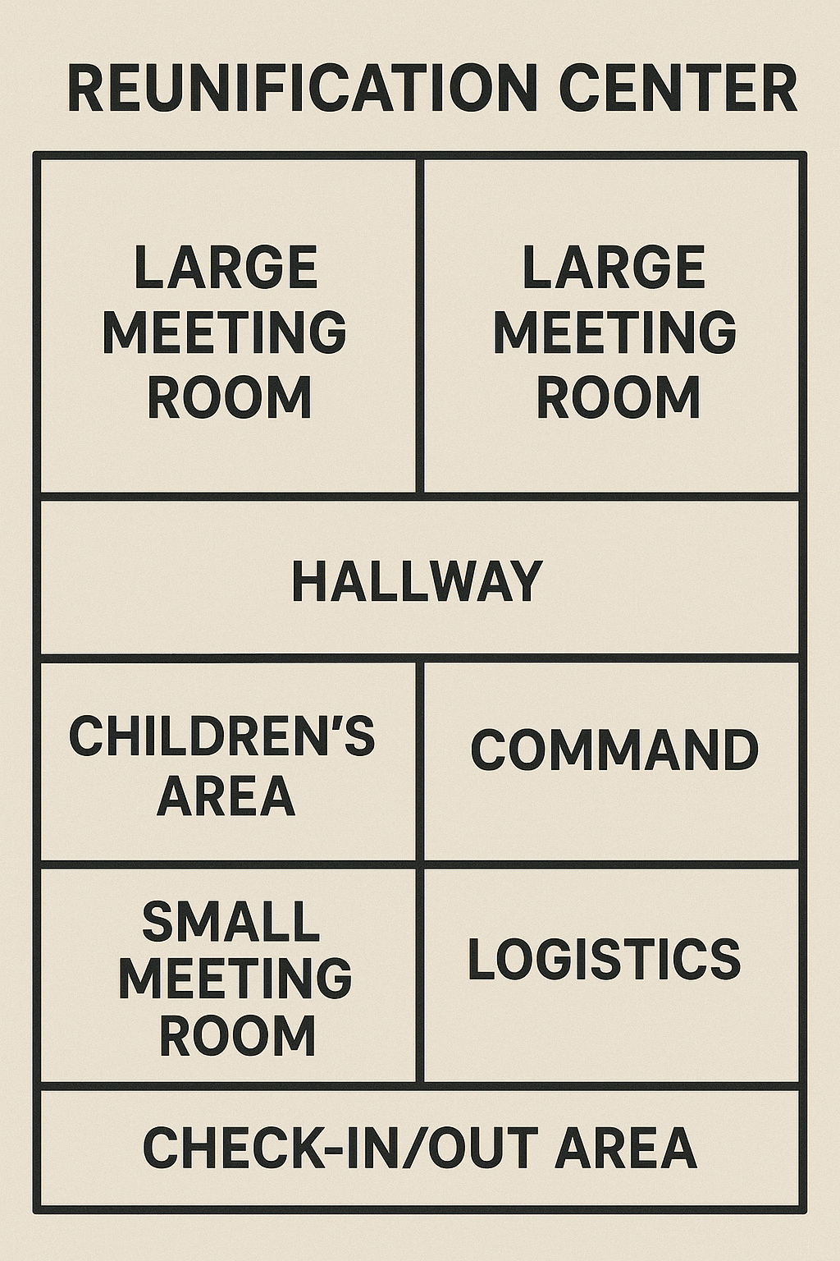
Reunification
Also consider calling it Notification or Information Center
Should be near the incident but not in the restricted area of the crime scene
Needs to be ADA accessible and have both large and small gathering spaces
Needs to be secured by Law Enforcement
Everyone who enters and exits must be accounted for

Slide 19
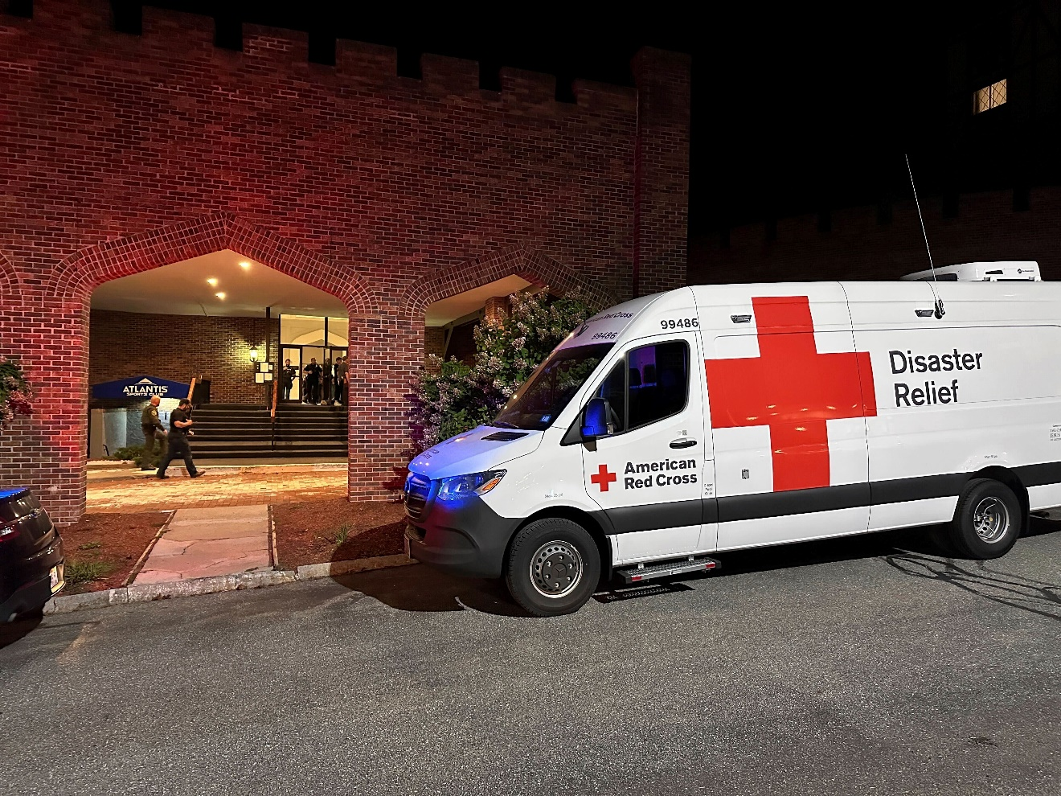
ARC Support
Site selection and procurement
Supply Support
People power for movement and tracking
DMH, DSC, and DHS
Hospital liaison/reunification support
Partner Coordination
Technology support (Web EOC)
Call Center (1-800-Red-Cross)
Feeding
Logistics supplies, and equipment

Slide 20
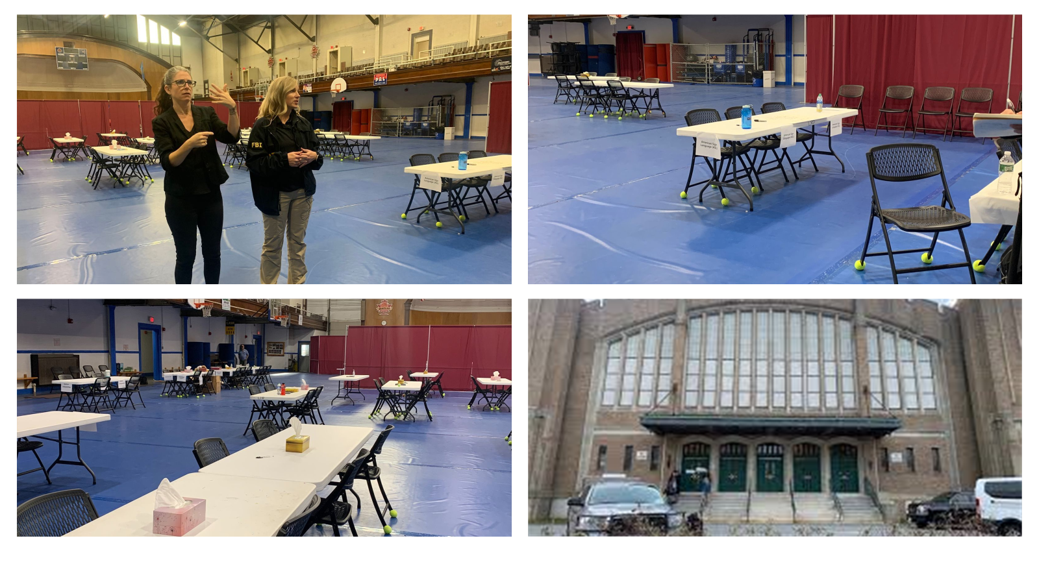
Family Assistance Center
Notes:
Challenges: sign language

Slide 21
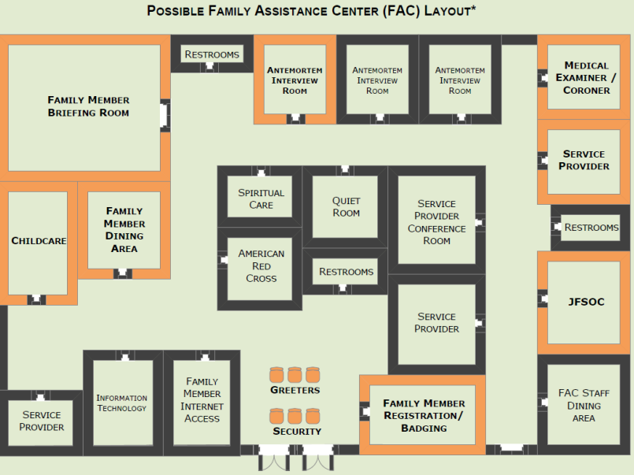
Family Assistance Center Layout Example
Notes:
Considerations:
Childcare
Audience/Community sensitivities
Feeding of site staff/clients
Rest spaces for site staff
Mental health support for site staff
Must have both public and private spaces
Must have a space for the security of personal effects and for distribution of effects
List coordination – Who has access, which one is the master list

Slide 22
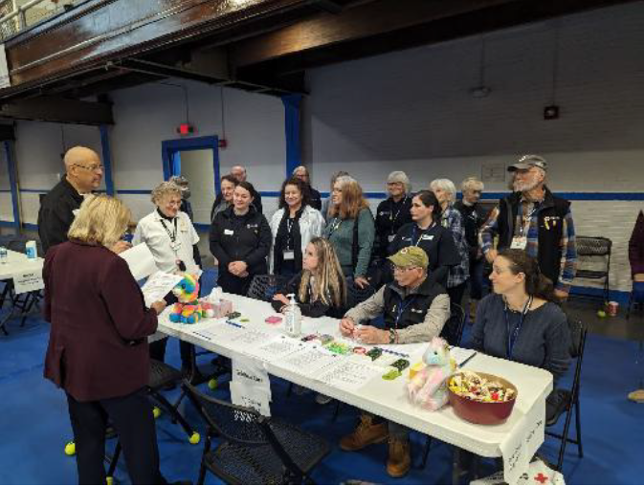
The Red Cross as a Resource Coordination Hub
In-kind donations support
Conduit for Chamber assistance requests
Elected Official Liaisons & External Relations support
Caseworker support for direct client assistance
Technology support
Coordination with partner NGOs
Notes:
Specifically Screened and Processed 26 in-kind offers and requests for this response: bottled water, teddy bears, hot cocoa/coffee/donuts, transportation, meals
Example: home heating oil requests do not fall under ARC but we coordinated with partner agencies
Relationship with federal and state gov and relationship with local gov...how it helped and hindered
Local relationships and door to door outreach.
Public affairs, mass casualty and how to tell our story.

Slide 23
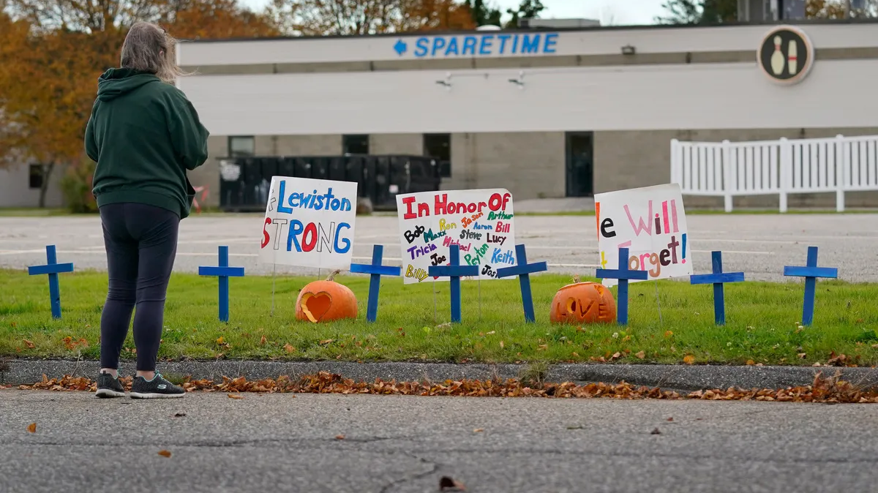
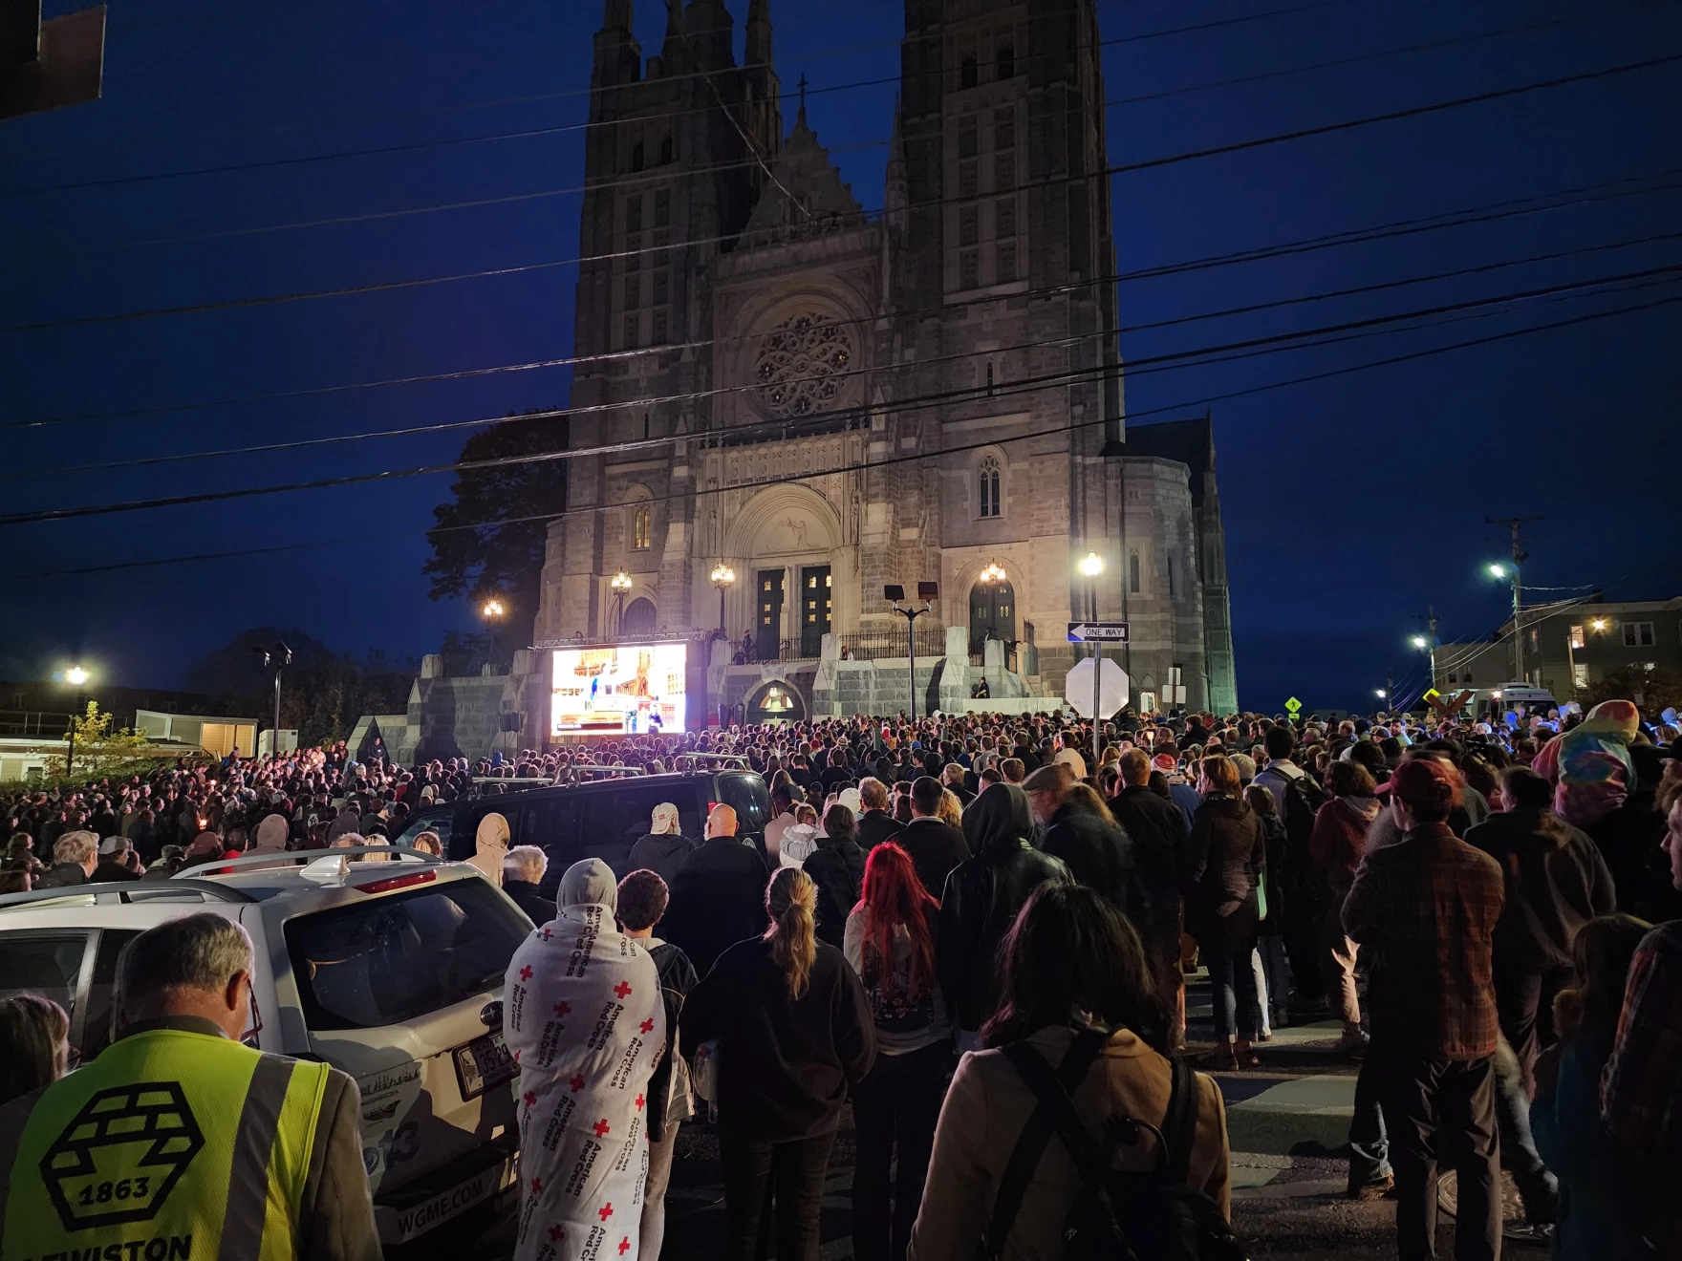
Supporting the Community
Susan Sharon/Maine Public
Notes:
Planned and spontaneous vigils
Halloween for the Community

Slide 24
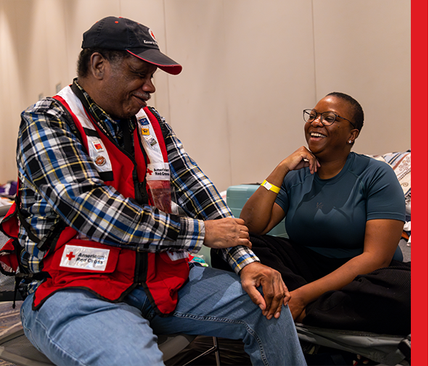
Integrated Care and Condolence Team (ICCT)
Red Cross volunteers specially trained to provide support and services for families whose loved ones are missing, injured or deceased because of a disaster.
Disaster Mental Health
Disaster Health Services
Disaster Spiritual Care
Recovery Casework
Notes:
The Integrated Care Condolence Team approach is a comprehensive service delivery method that provides coordination and provision of services to families whose loved ones are missing, injured or deceased. Casework and recovery planning, disaster spiritual care, disaster mental health and disaster health services are offered concurrently as needed in order to minimize intrusion and maximize care, comfort and support. Services are delivered to families during all types of responses, from single family fires to incidents with large numbers of fatalities, injuries or missing.

Slide 25
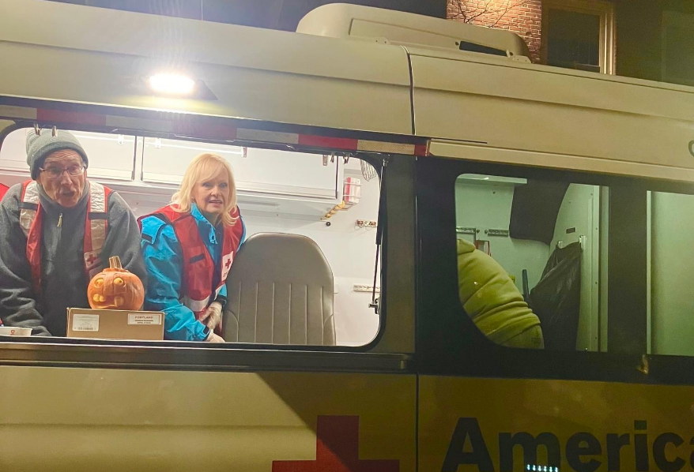
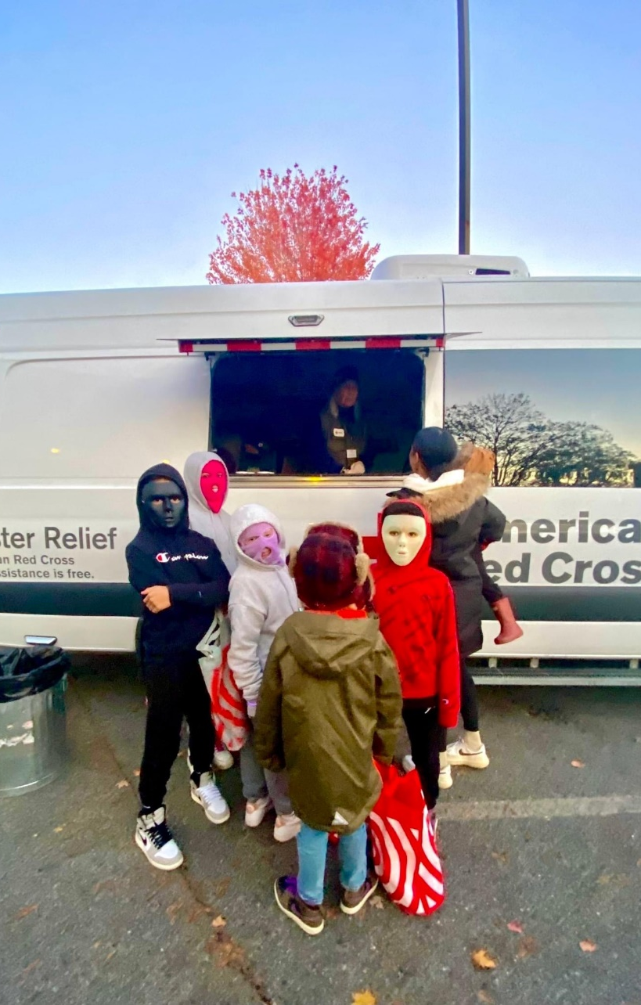
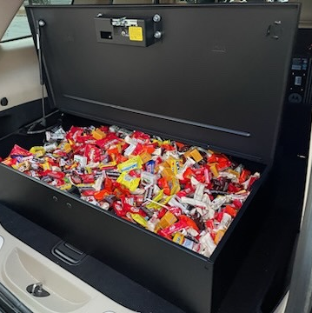
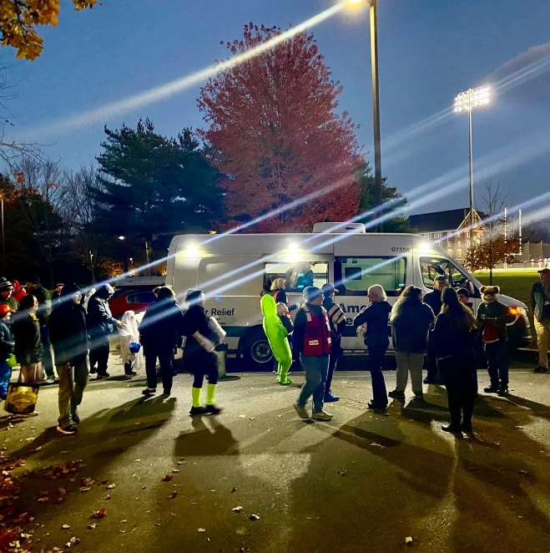
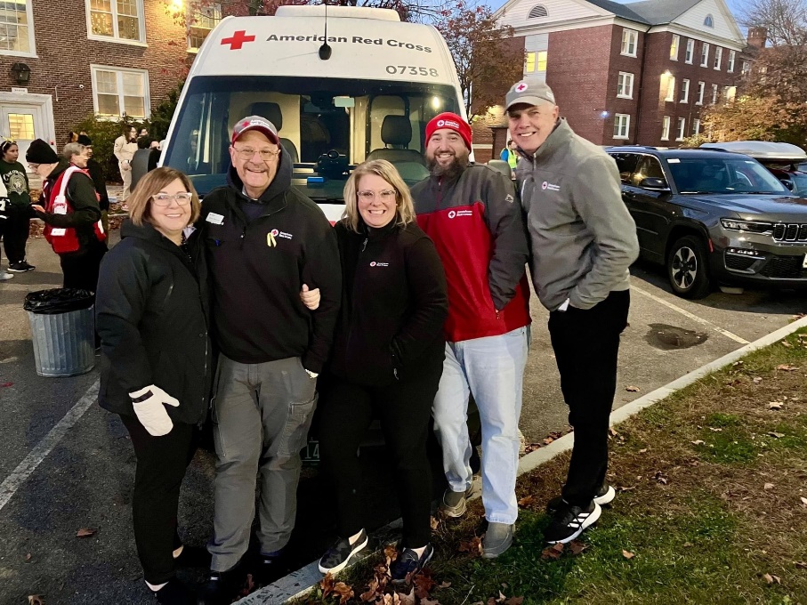
Halloween for the Community
Notes:
Hosted by Bates College
the first non vigil related public gathering in affected community since the shooting

Slide 26
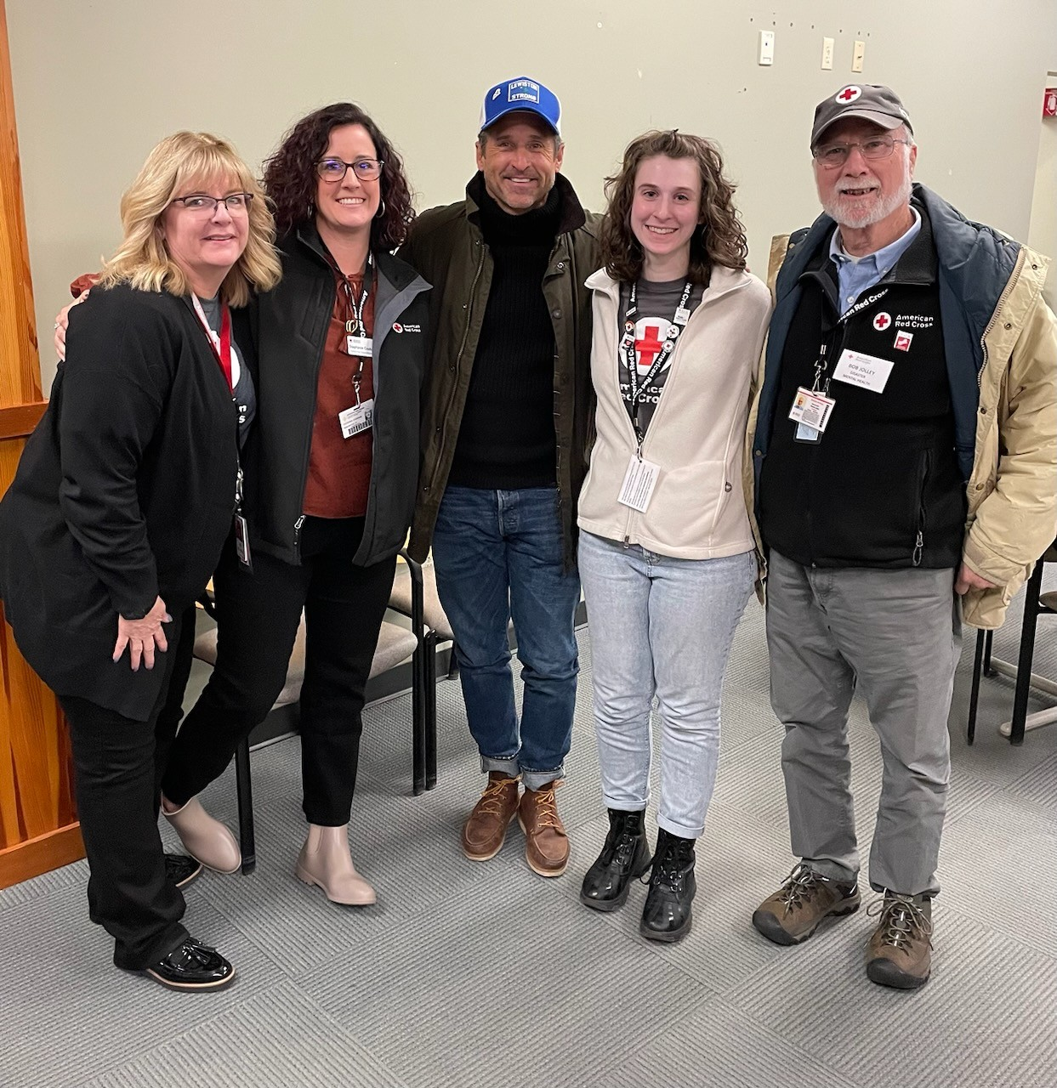
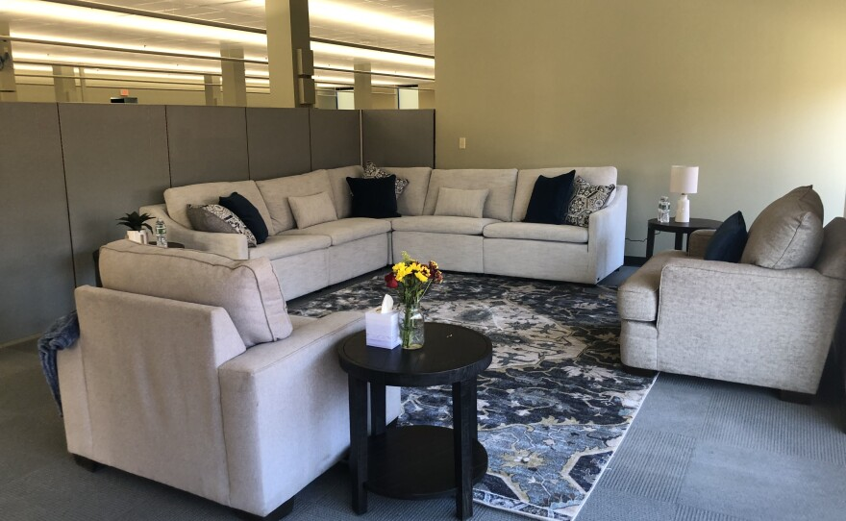
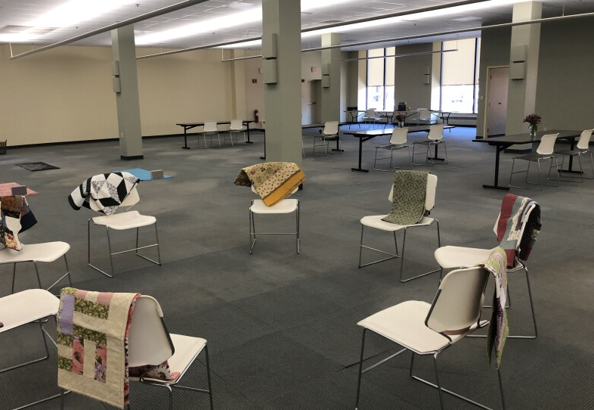
Maine Resiliency Center
Notes:
Community gathering place
Resources
Caseworkers and Mental Health volunteers
Distribution of holiday meals

Slide 27
Healthcare Partner Coordination
Governmental
Discuss Protocells and Triage procedures
Plan communications and invest in radio/redundancy
Practice during pre-planned events
Coordinate and participate in the Joint Information System
Participate and explore joint funding opportunities to help improve future coordination
Non-Governmental
Engage your local and state VOAD groups
Treat them the same as your governmental partners
Understand their capabilities and resources
Be realistic about their capacity and understand their timeline to build a response
Many hands make less work

Slide 28
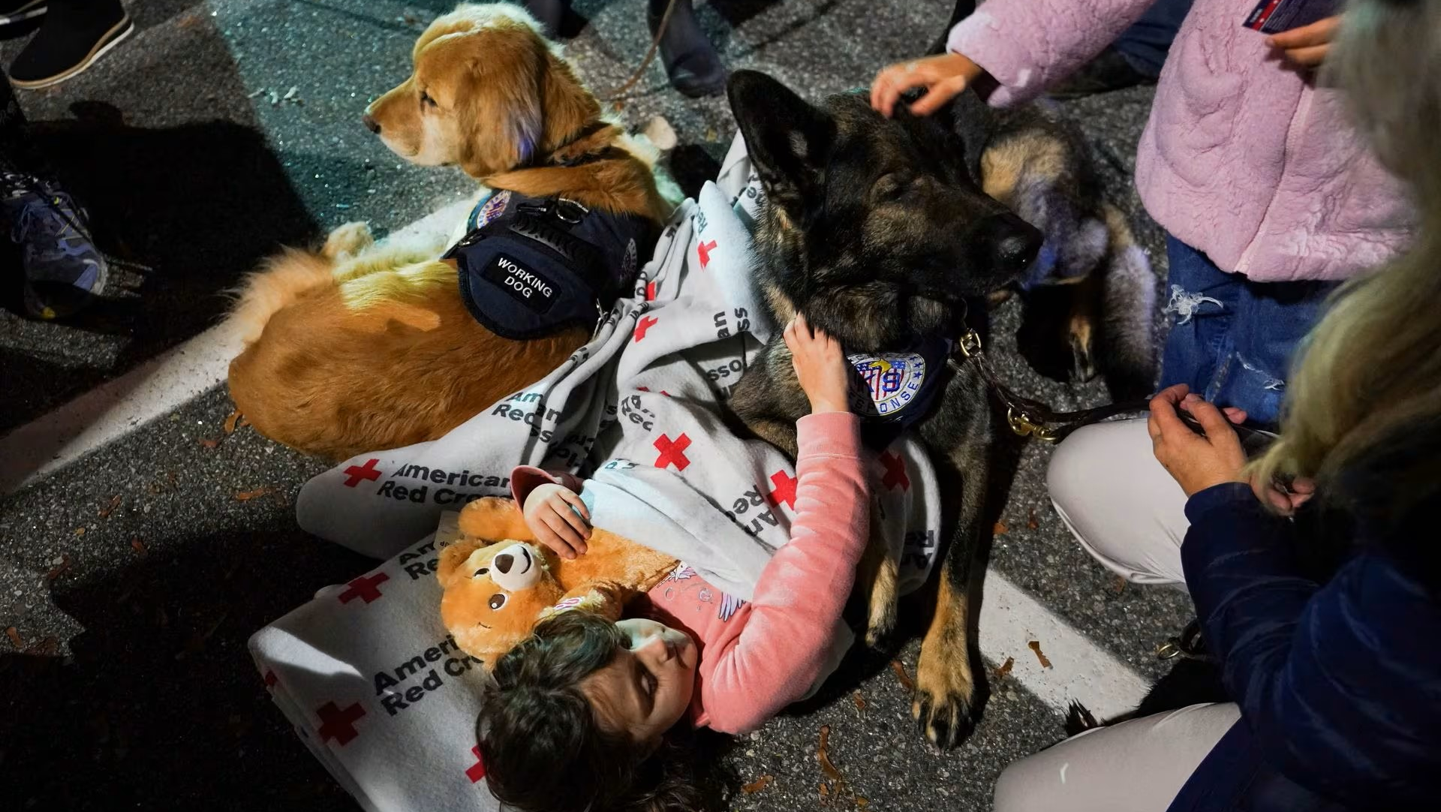
This is why we do what we do

Slide 29
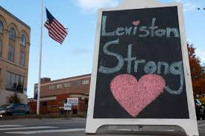
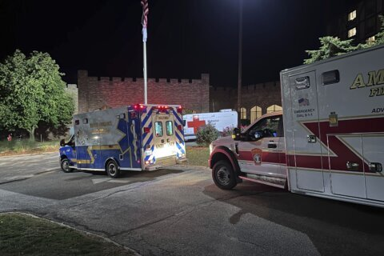
Successes Nashua and Lewiston
Halloween event
Strengthened relationship with Victims Advocates
First use of MOU with FBI
First test of hospital liaison was extremely successful
Strong support and future planning with Nashua area partners. PD, FD, EMS, hospitals, EM
Tremendous community Support
Notes:
Lockdown lasted 2-3 days which delayed mass care response
Need for sign language interpreters
we had were not be able to actively send correspondence, as we take a reactive/passive approach to mass causalities
AAR highlighted breakdown in agency communications – need to build relationships BEFORE a MCI

Slide 30
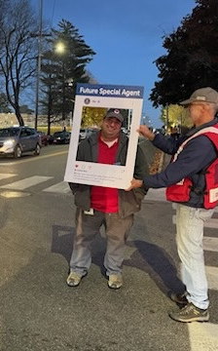
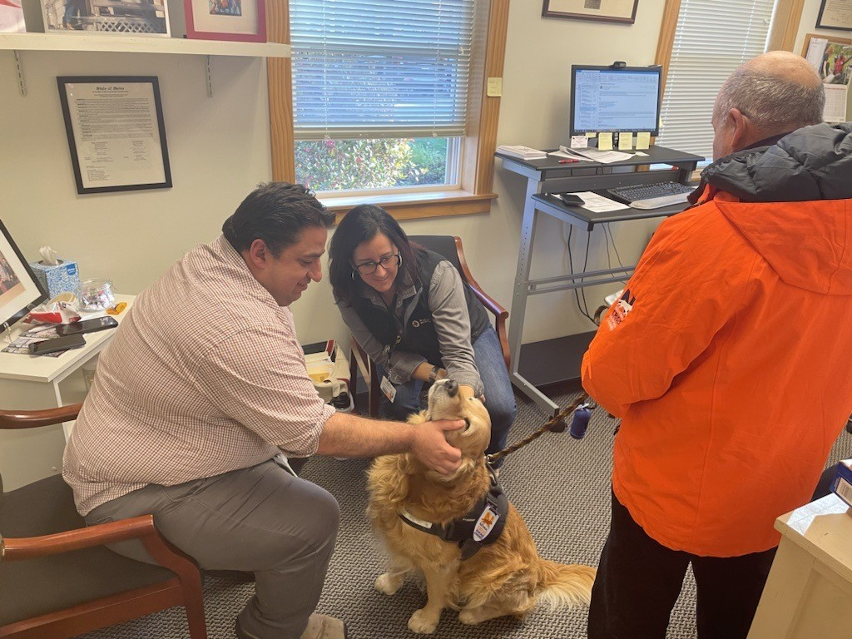
Q&A

