Slide 1
Introduction to CLMRN
(Connecticut Land Mobile Radio Network)
Scott Wright, EMT/ENP/CMCP
Deputy SWIC
DESPP/DSET

Slide 2
Agenda
What is DSET?
What is CLMRN?
Examples of use
How to be involved with CLMRN
Q&A

Slide 3

Introductions…
Nearly completed 36 years of state service
Experience as an EMT, Firefighter, DOC, etc.
Extensive experience in land-mobile-radio
Serves as chair/vice of a number of national and regional committees
Deputy Statewide Interoperability Coordinator (SWIC)
Certifications and licenses, etc…

Slide 4
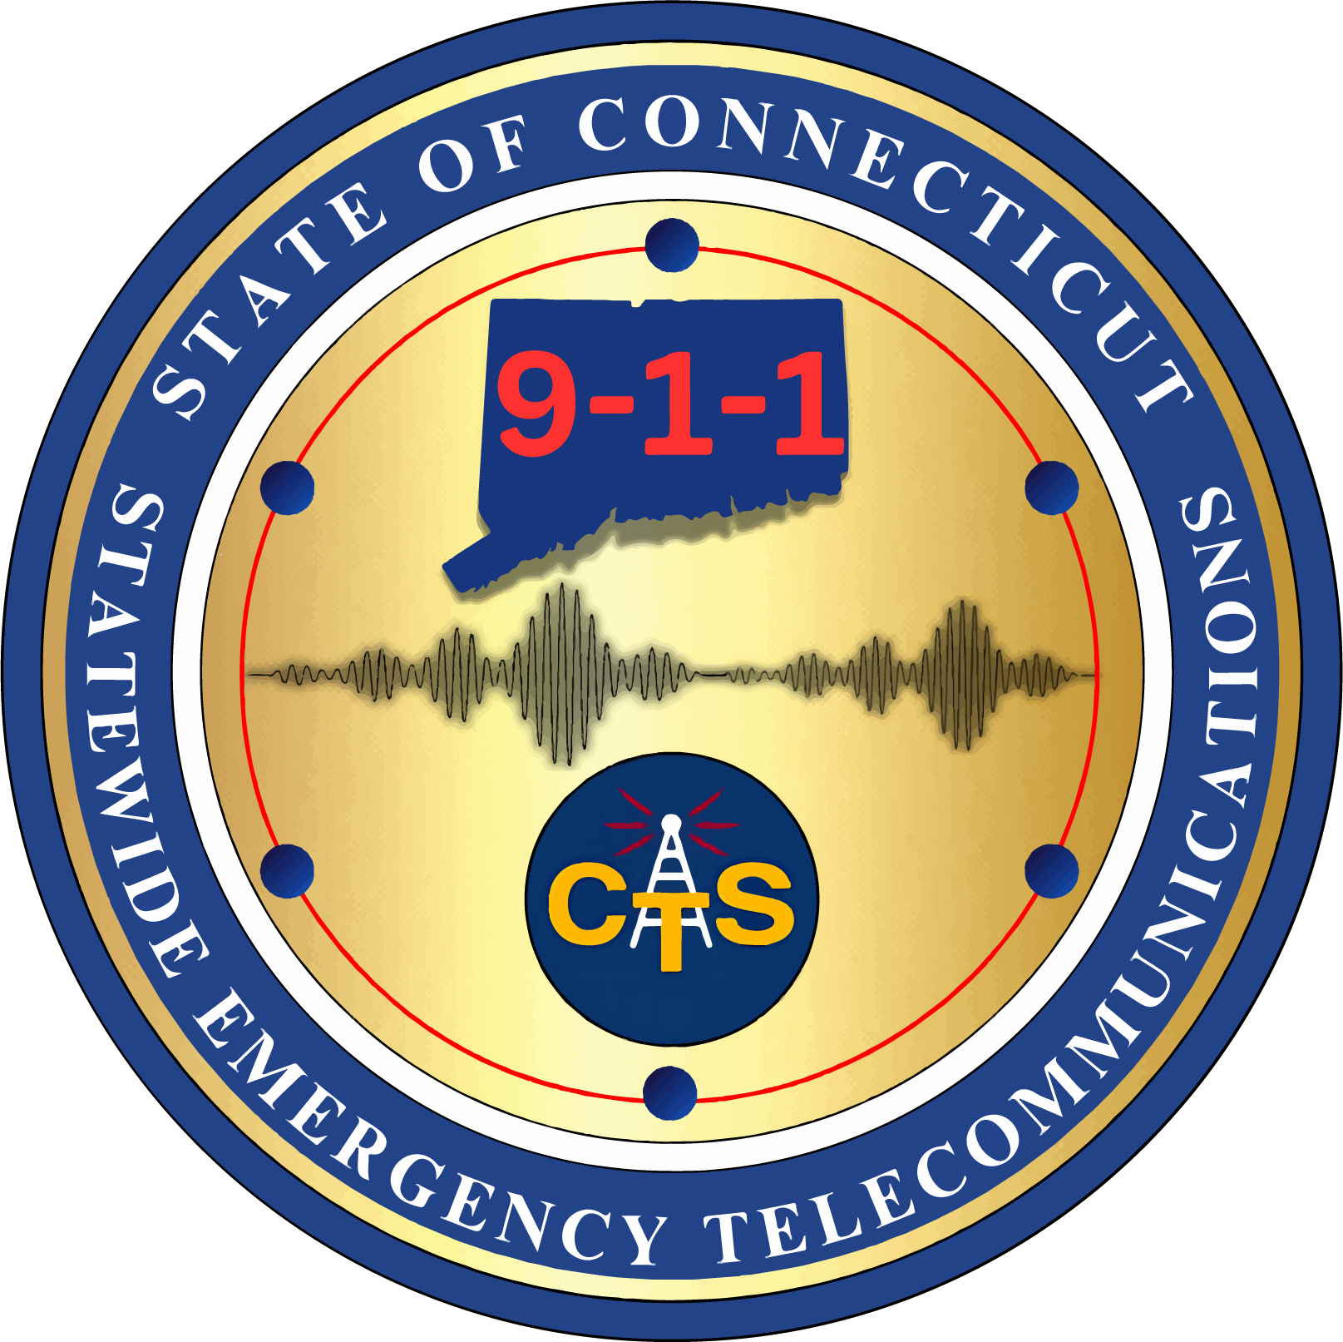
DSET
Division of Statewide Emergency Telecommunications
One of six divisions of DESPP
Responsible for public safety communications
NG911-including PSDN/BTOP
Operable and interoperable communications
Network Control Center
Everbridge Notification

Slide 5
CLMRN
Connecticut Land Mobile Radio Network
Several different things:
- Common interoperability platform
Consoles
Gateways
- Statewide 7/800 mhz based radio system
Designed and tested to provide 98% mobile coverage statewide – many areas of MUCH better than that

Slide 6
CLMRN
Connecticut Land Mobile Radio Network
Console System
288 Consoles on network
Not all use the trunked radio system
Each PSAP has an audio gateway for access to the system
Allows for improved interoperability

Slide 7
CLMRN
Connecticut Land Mobile Radio Network
Radio System
2 “Zones” (East/West)
15 Simulcast systems
8 standalone sites
6 deployable sites
3 other systems connected – more to come

Slide 8
CLMRN
Connecticut Land Mobile Radio Network
Radio System
2025
PTTs: 112,090,096 / 41,224,016
Airtime (sec): 641,796,378 /
Avg PTTs/Minute: 213.5
Avg PTT Length (sec): 5.9
Active Talkgroups: 1055

Slide 9
CLMRN
Connecticut Land Mobile Radio Network
Radio System
Radios: 36036 (4/4/26)
Avg Radios Added: 333
Avg Alias’ Changed: 358

Slide 10
CLMRN
Connecticut Land Mobile Radio Network
Sites on/near hospitals:
Bridgeport
Danbury
Hartford
New Haven
Norwalk
Sharon

Slide 11
CLMRN
Connecticut Land Mobile Radio Network
Projects Recently Completed
DMHAS (consoles/subscribers)
Yale (sub-system/consoles/subscribers)
New London (consoles/subscribers)
Berlin (consoles/subscribers)
Newington (consoles/subscribers)

Slide 12
CLMRN
Connecticut Land Mobile Radio Network
Projects Underway
Mohegan Tribe (interconnected consoles/site/subscribers)
East Windsor/Windsor (system integration, sub-system, consoles, subscribers)
Waterford (sub-system/consoles/subscribers)
DOC (subscribers)
Windham (interconnected consoles/subscribers)

Slide 13
CLMRN
Connecticut Land Mobile Radio Network
Projects in Planning
Naugatuck (sites, consoles, subscribers)
East Lyme (sites/consoles/subscribers)
LMR/LTE Integration
Lifecycle planning

Slide 14
CLMRN
Connecticut Land Mobile Radio Network
Core Beliefs: Backup to the Backup to the Backup
Minimize any impact to the end user
Monitoring (If you can monitor it, we do)
Redundancy
Spare parts (10% spares)
Vendor SLAs (2 hour respond/4 hour restore)
Control of our own networks (microwave/fiber)

Slide 15
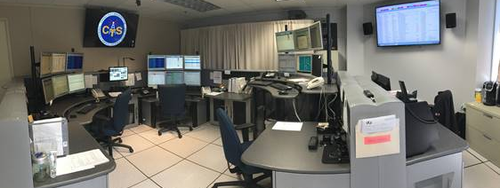
CLMRN
Connecticut Land Mobile Radio Network
Monitoring:

Slide 16
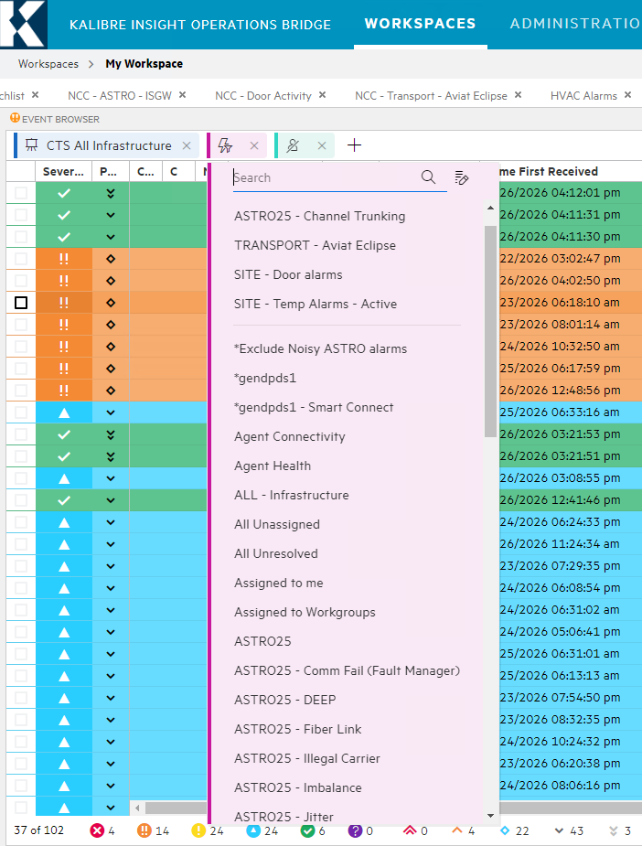
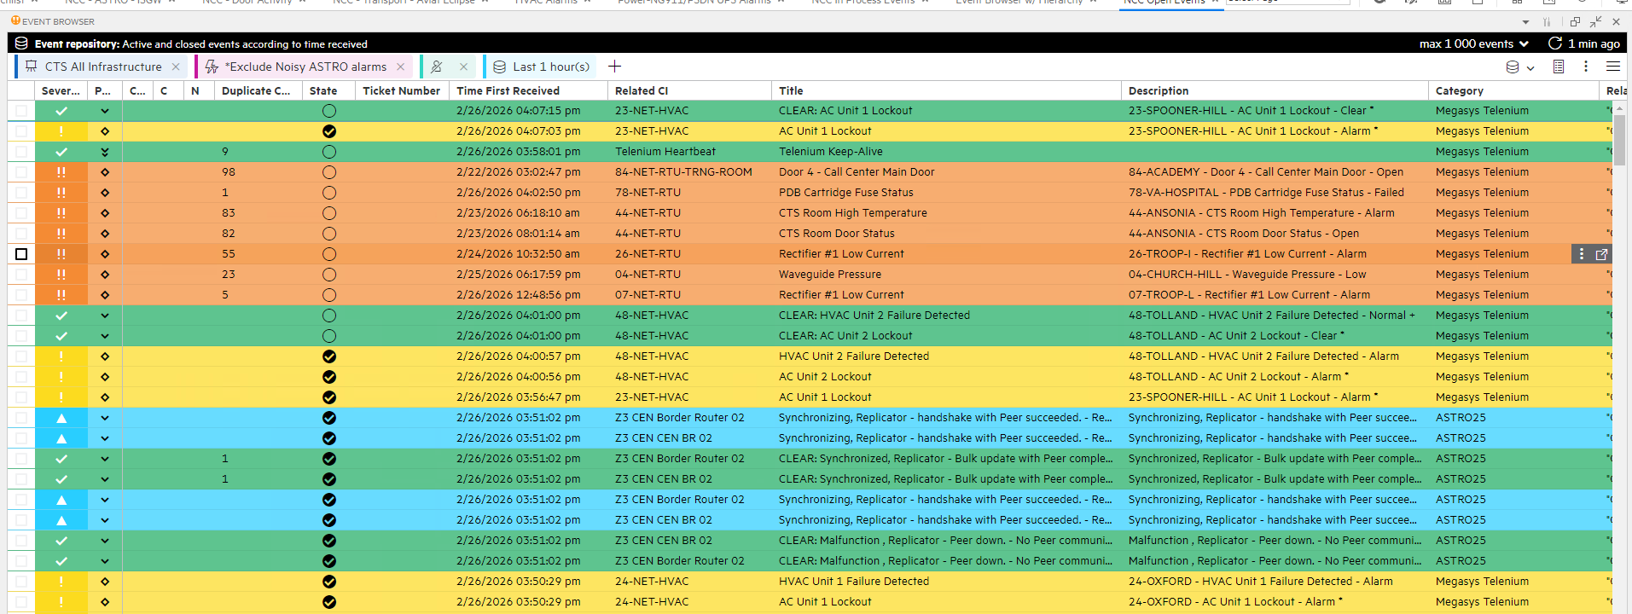
CLMRN
Connecticut Land Mobile Radio Network
Monitoring:

Slide 17
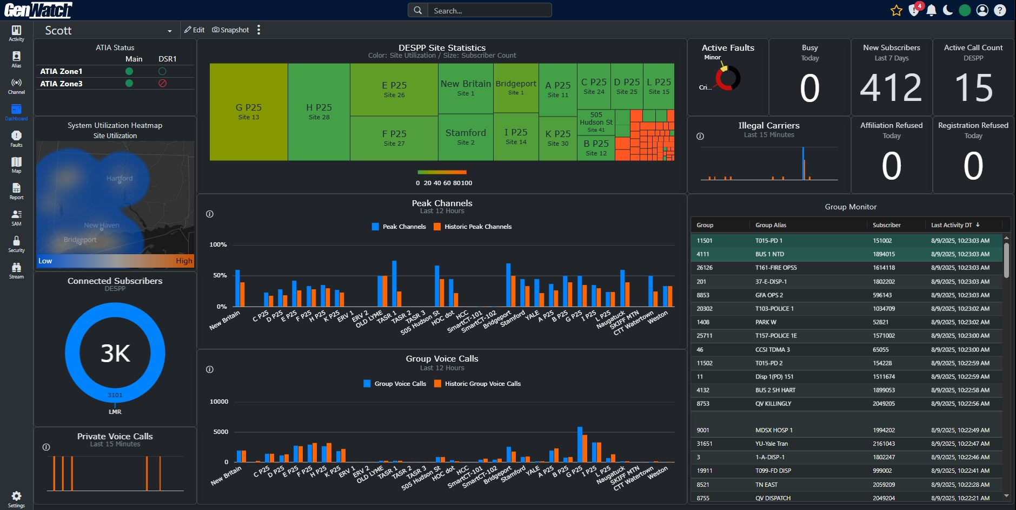
CLMRN
Connecticut Land Mobile Radio Network
Monitoring:

Slide 18
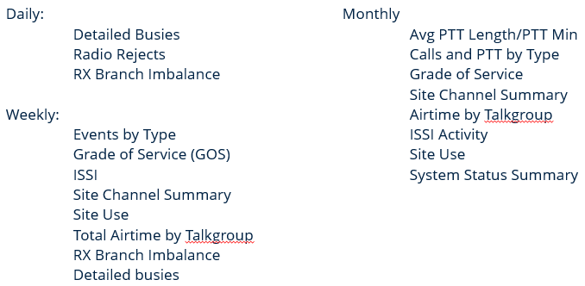
CLMRN
Connecticut Land Mobile Radio Network
Monitoring:

Slide 19
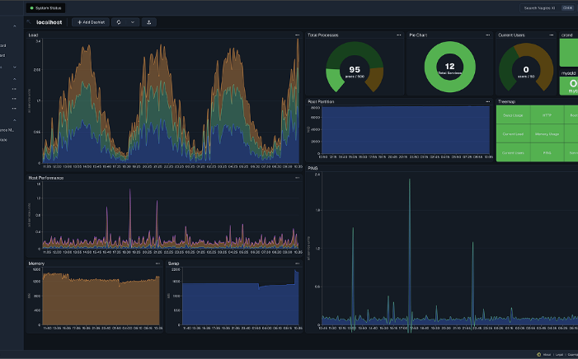
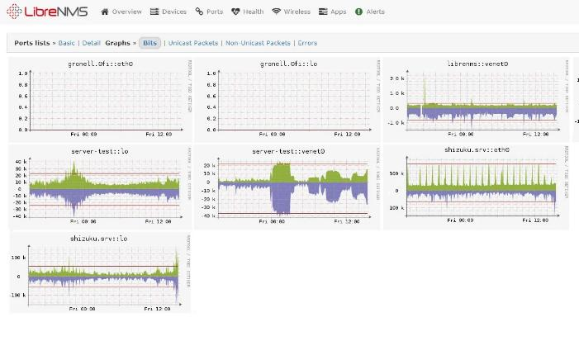
CLMRN
Connecticut Land Mobile Radio Network
Monitoring:

Slide 20
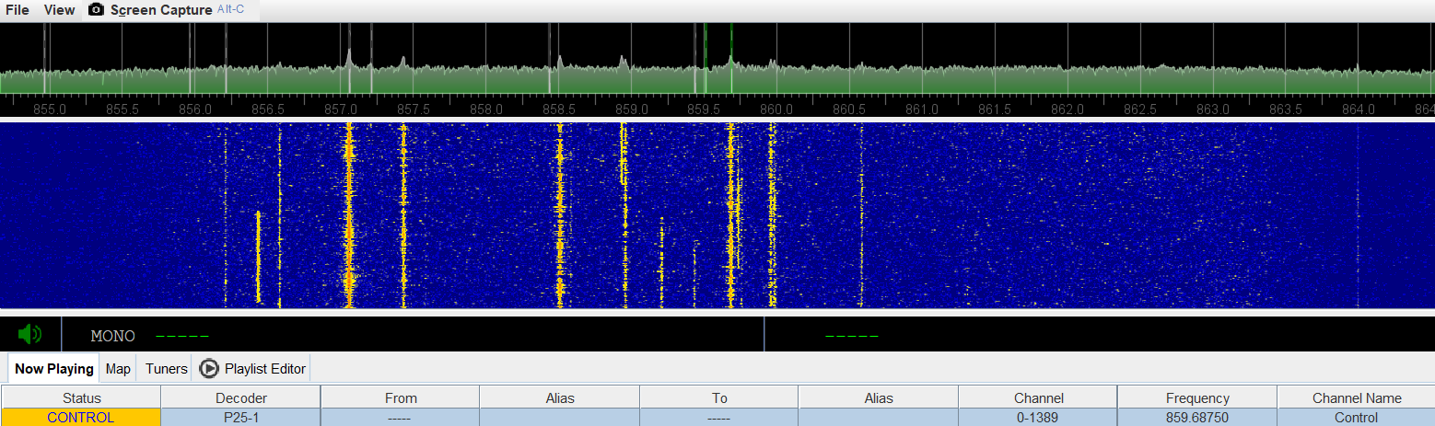
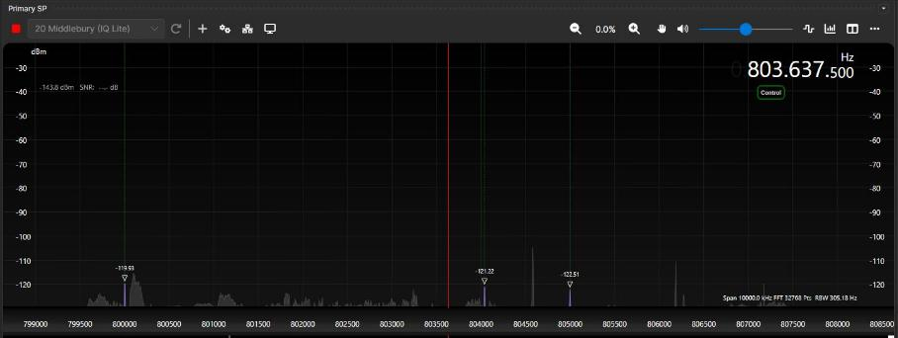
CLMRN
Connecticut Land Mobile Radio Network
Monitoring:

Slide 21
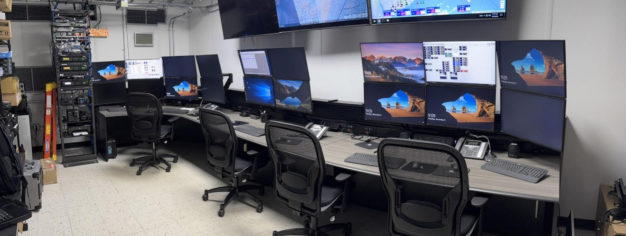
CLMRN
Connecticut Land Mobile Radio Network
Backup:

Slide 22
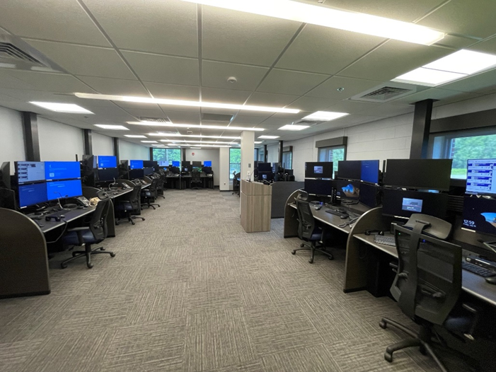
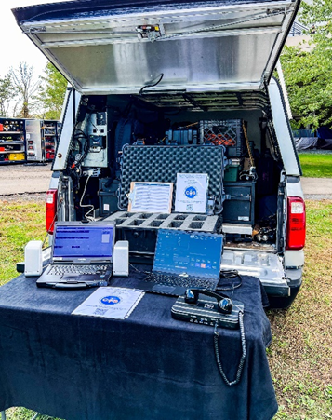
CLMRN
Connecticut Land Mobile Radio Network
Backup:

Slide 23
CLMRN
Connecticut Land Mobile Radio Network
Considerations:
- System consists of both 700 and 800 frequencies
- Eligibility: governmental – with some exceptions
The system is not common carrier/commercial
Must meet eligibility requirements to use it
NGO’s require governmental sponsorship (47CFR90.523(b))

Slide 24
CLMRN
Connecticut Land Mobile Radio Network
Considerations – 47USC337:
(1)Public safety services The term “public safety services” means services—
(A) the sole or principal purpose of which is to protect the safety of life, health, or property;
(B)that are provided—
(i)by State or local government entities; or
(ii)by nongovernmental organizations that are authorized by a governmental entity whose primary mission is the provision of such services; and
(C)that are not made commercially available to the public by the provider.

Slide 25
CLMRN
Connecticut Land Mobile Radio Network
Considerations (continued):
- As the system has been constructed in part using tax-free bonds, there are IRS considerations as well that need to evaluated..carefully

Slide 26
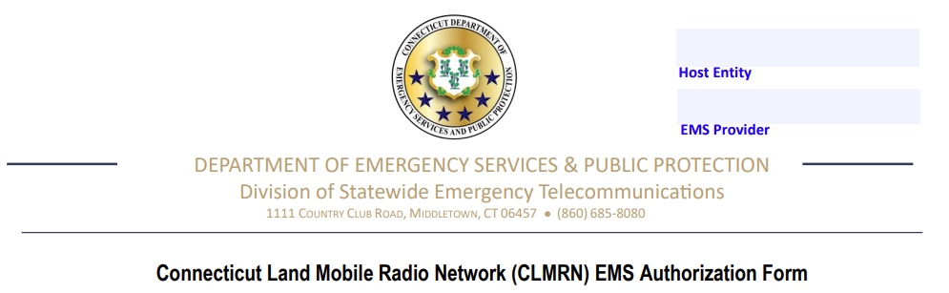
CLMRN
Connecticut Land Mobile Radio Network
EMS Authorization Form:

Slide 27
CLMRN
Connecticut Land Mobile Radio Network
CMEDs with Console Connectivity:
LCD
NWCTPS
SWRCC
TN
Waterford (future)
Valley Shore

Slide 28
CLMRN
Connecticut Land Mobile Radio Network
Potential Future Uses:
Replacement for MedNet/MedSat
Medical/Disaster Response & Coordination
What else?

Slide 29
CLMRN
Connecticut Land Mobile Radio Network
How to get involved:
Send email to p25@ct.gov
You’ll be working with Mark Gorka and Chauntenay Young on our base agreement and the Engineering staff on what the needs and equipment are.

Slide 30

Questions??

Slide 31
Thank you!
Scott Wright
scott.wright@ct.gov

